Slide 1
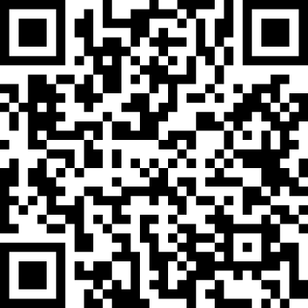
Website: https://handlewithcareok.org/
Email: info@handlewithcareok.org
CLEET Approved: Training #23-02095
Creating Connections to Support Oklahoma’s Youth
Mental Health 1.0 CEU
Updated 9/25/2023
OSDH Planning Grant: Health Disparities Aug. 1, 2022 – May 31, 2023
Notes:
Handle With Care Oklahoma is a collaborative of many partners working together to connect youth to supports, as needed, after a traumatic event. The lead law enforcement agency is the Oklahoma Office of Homeland Security.
The Public Health Institute of Oklahoma is a neutral convener that provides backbone support. The Oklahoma State Department of Health provided a ten-month planning grant to advance statewide implementation.
Overview for Speakers:
Slides 1-4 Adrienne
Slide 5- 6 story from Gary (2min)
Slides 7 - 24 Adrienne
Slides 25 - 34 Gary
Slides 35 - 44 Adrienne
Slides 45 - 51 Brittany
Slides 52 - 68 Adrienne
Confirmation: - I have no financial relationships with a commercial entity producing healthcare related products and/or services.

Slide 2
Interagency Planning Committee:
Gary Shelton, Keith Stewart
Oklahoma School Security Institute
Notes:
Handle With Care is enhancing existing collaborations and partnerships between law enforcement, schools, communities and state agencies.
These are some of the agencies that are on the planning committee.

Slide 3
Objectives:
Steps for HWC Implementation (criteria, procedure, and response to notification)
Process to enhance local existing partnerships and school-based efforts
Strategies to Increase Sustainability
Notes:
Objectives

Slide 4
Interagency Roadmap: Handle With Care
Family Story, HWC Overview, & Community Need
Law Enforcement (criteria & procedure)
Schools: Urban & Rural (response to notification)
Community & School-Based Behavioral Health (supports)
Community & School-Based Social Services (supports)
Community & School-Based Health Services (supports)
Notes:
Agenda

Slide 5
Prevention
Early
Intervention
Crisis Event
Notes:
Story

Slide 6
Simple Strategy: All first responders maintain communication with schools regarding children/teens exposed to a traumatic event, so all children can feel safe and learn.
Notes:
Handle With Care is a simple strategy that creates a communication process for law enforcement to notify schools when a child or teen has been exposed to a traumatic event. No details are given. This simple communication creates a positive ripple effect for the child, family, school and community. All children should feel safe so they can learn.

Slide 7
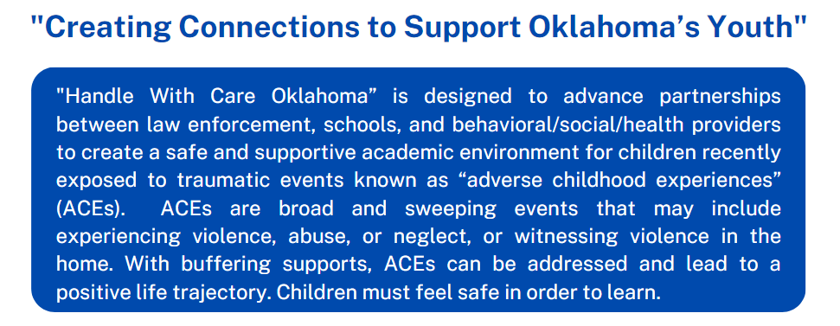
Notes:
HWC advances partnerships between law enforcement and schools to help provide a safe and supportive academic environment for children recently exposed to traumatic events.

Slide 8
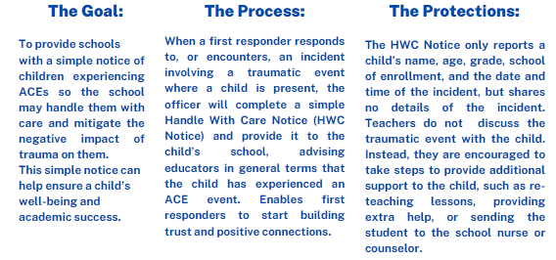
Notes:
The Goal
The Process
The Protections

Slide 9
Overview Video & “Handle With Care: Community Spotlights”
First responders often walk away from a traumatic scene wishing they could do more for the kids…..
Source: 9 min Overview to Share with Community
https://vimeo.com/380526937
Tahlequah Video: (rural partner) https://www.youtube.com/watch?v=JXe-n10xNdI
OKC Video: (urban partner) https://www.youtube.com/watch?v=lKPady_4vGw
Notes:
Since 2018, the Handle With Care OK Collaborative has worked with over 35 communities to increase coordination and communication.
We have several videos that highlight urban and rural partners, as well as an overview video.

Slide 10
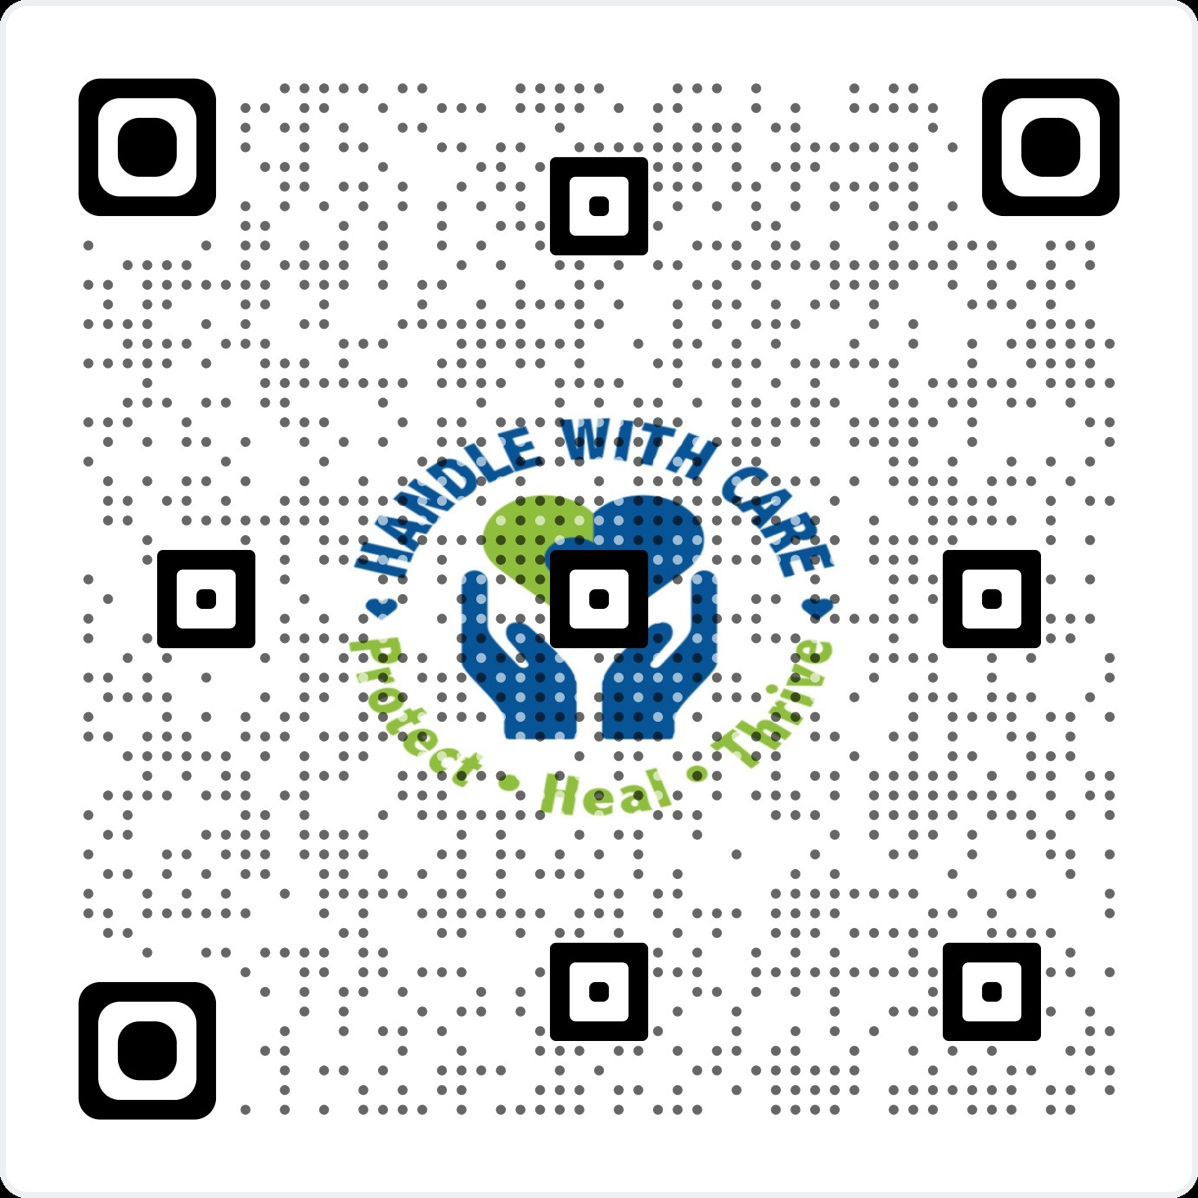
Statewide website: https://handlewithcareok.org/
Monthly Statewide Planning Meetings
Monthly planning call:
1st Wednesdays
10-11am https://us02web.zoom.us/j/84481751587
Trainings available upon request
Email: info@handlewithcareok.org
Special thanks to OTPC and PHIO for incubating and providing backbone support:
How to advance Handle With Care Oklahoma in your community?
Notes:
OK Turning Point made the first initial investment into the Oklahoma initiative by sending a team to the national HWC conference and investing into a statewide website.
With the support of the Public Health Institute of Oklahoma, a neutral convener, we have established a statewide website and hold monthly statewide planning calls.
We aim to support community implementation, address barriers, celebrate milestones, and work with local communities to advance trauma-informed strategies across the state.

Slide 11
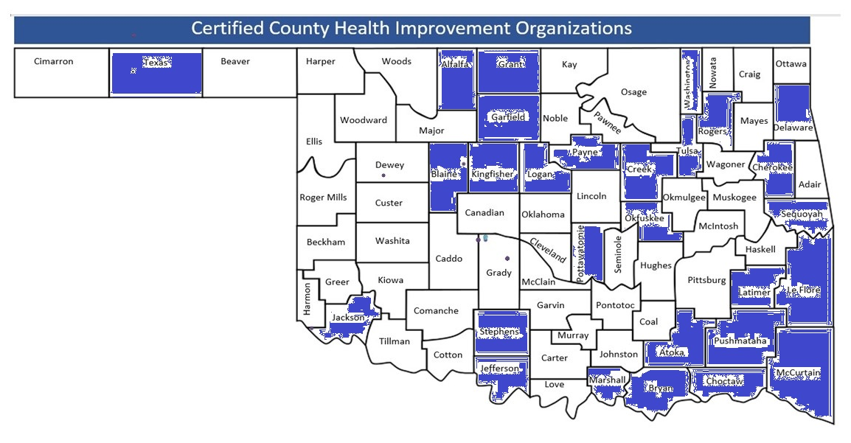
Examples of Innovative Communities
Community Health Improvement Organizations (CHIOs)
To learn more about CHIOs & apply, please visit: https://publichealthok.org/county-health-improvement-organizations/
Notes:
With community partners across the state, like the Community Health Improvement Organizations (CHIOs), we have been able to reach over 35 communities across the state.
Supports for planning, implementation, and sustainability
funding the gaps

Slide 12
Partners Supporting Integrated HWC Trainings that Enhance Existing School-Based Partnerships and Collaborative Efforts Sector-Specific Training: 911 Dispatch Centers: RB Hauf (RAVE) Law Enforcement: Gary Shelton (CLEET), Keith Stewart (OK School Security Institute - Mission SOS) Schools: Sheri Fleming, Cindy Swearingen (OSDE - Safe & Healthy Schools) Mental Health: Brittany Couch & Cory Sutton (ODMHSAS - Behavioral Interventions and Support Services Schools & CIT) Social Services: Monica Brumnett & Heather Cristiano (OKDHS - School-based Specialists)
Health Services: Karin Leimbach (OSDH - Whole School, Whole Community, Whole Child) District Attorney: Jennifer Crilly, Director of Training (DA Council) Coalitions: Robert Lee/Doug Ishmael (Evolution Foundation - Systems of Care Coalitions) Monthly HWC OK Community Support Calls: (all are welcome) 1st Wednesday of the Month 10:00am – 11:00am https://us02web.zoom.us/j/84481751587 hosted by Public Health Institute of Oklahoma Calendar Series Invitation Link: Click Here
Notes:
The HWC OK Collaborative is successful with the diverse support of many cross-sector partners and integrating HWC into their current trainings to enhance existing initiatives

Slide 13
Handle with Care
2023
Washington
Montana
Maine
North Dakota
Minnesota
Vermont
Oregon
New Hampshire
Idaho
South Dakota
Wisconsin
New
York
Massachusetts
Wyoming
Michigan
Rhode Island
Connecticut
Iowa
Pennsylvania
New Jersey
Nevada
Nebraska
Indiana
Ohio
DC
Delaware
Utah
Illinois
West
Virginia
Maryland
California
Colorado
Virginia
Kansas
Missouri
Kentucky
North
Carolina
Oklahoma
Tennessee
Arizona
New Mexico
Arkansas
South
Carolina
Alabama
Georgia
Mississippi
Interest
Development Phase
Active
Texas
Louisiana
Alaska
Florida
Hawaii
*Oklahoma is recognized as a top five state in the nation in creating a statewide HWC initiative
Notes:
Because we have built this strong foundation together, Oklahoma is being recognized as one of the top five states in the nation to have a statewide initiative. We should be very proud of what we have built so far together and continue to collaborate to help communities facing many adversities.

Slide 14
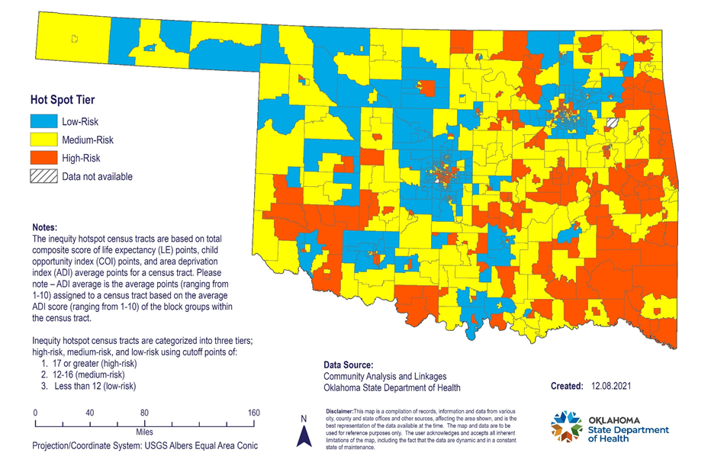
Why is this important? Families across Oklahoma are experiencing multiple adversities One agency or organization cannot “fix” this alone.
Oklahoma Inequity Hot Spots
Source: https://www.okintheknow.org/wellness-county-profiles/
Notes:
We have zip codes with high density of families experiencing multiple adversities; there is a need for increased coordination and co-designing solutions with communities and individuals with lived experience
One organization/agency/community cannot improve the health of all Oklahomans alone…..

Slide 15
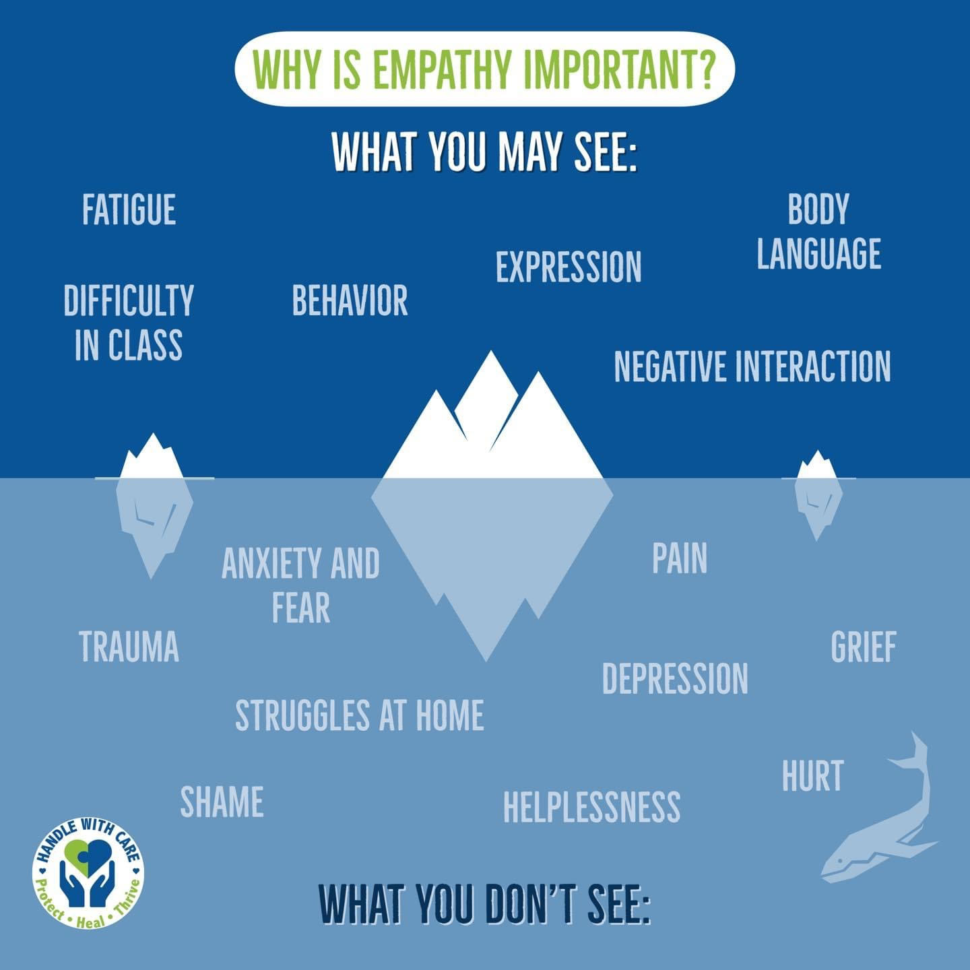
Learning about adversity and increasing empathy, increases opportunities for communities to connect children and families to resources as needed.
Notes:
Adversity consists of a wide range of experiences or conditions that threaten the health and well-being of children, families, and communities. Like resilience, adversity occurs across all levels of the social-ecological model. The understanding of adversity and its impacts on health and well-being continue to grow. The acronym ‘ACE’ can be defined in four primary ways: Adverse Childhood Experiences: Impact individual & interpersonal conditions. Examples include parental mental illness, substance abuse, interpersonal violence, homelessness, incarceration, divorce, death, emotional, physical, and sexual abuse, caregiver separation, and medical crisis.
Adverse Community Experiences: Impact population conditions. Examples include poverty, structural racism, community disinvestment, police violence, lack of affordable housing, lack of opportunity and economic mobility, discrimination, disconnected relationships, unemployment, and deteriorating built environments.
Adverse Climate Experiences: Impact community conditions. Examples include COVID-19, climate change, wildfires, droughts, hurricanes, earthquakes, floods, environmental injustice, and pollution.
Atrocious Cultural Experiences: Impact macro and socio-historical conditions. Examples include slavery, genocide, colonization, segregation, forced family separation, removal of property, and other harmful social norms such as low sense of political and social efficacy and mistrust.
Adversity consists of a wide range of experiences or conditions that threaten the health and well-being of children, families, and communities. Everyone is at risk for adversity. Historical, social, environmental and economic environments can contribute to inequities in exposure to adverse childhood experiences.12 Without the presence of protective factors and resilience strategies, both individual and multiple ACEs contribute to chronic stress and trauma for both individuals and communities across generations.

Slide 16
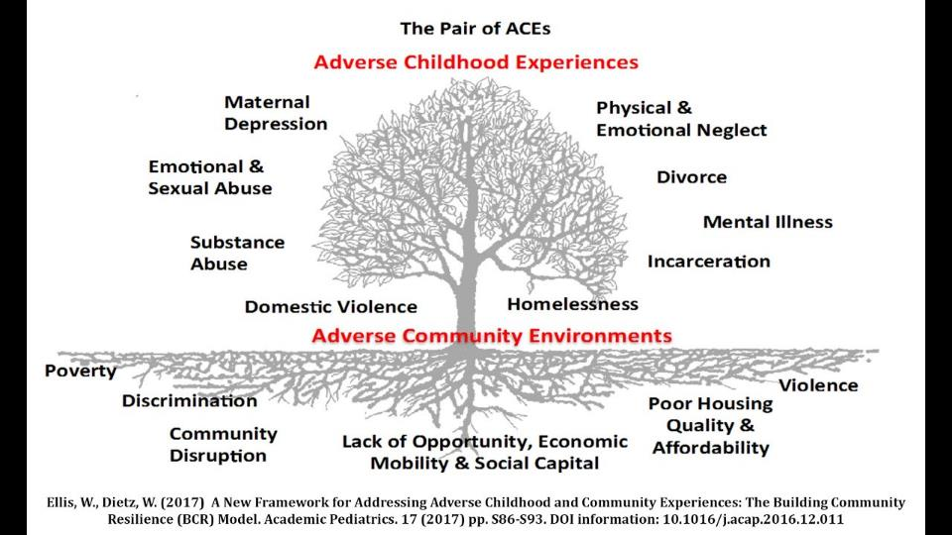
What is the root cause of generational adversities and health inequities?
= The seed of generational adversity is the prolonged activation of stress response systems in the absence of protective relationships; toxic stress; relational poverty.
Notes:
The Pair of ACEs” is an important visual aid that paints a more complete picture to help us understand the complexity and interconnectedness of adversity. It not only highlights individual adversities above the barren tree branches, but just as important, it highlights the community adversities within the toxic soil. If ignored, these adversities can be easily passed down from generation to generation. It is perpetuated, unless intentional strategies are implemented.
As a society, we are often overwhelmed, distracted and divided with limited resources trying to tackle each of these adversities separately. However, with increased understanding of the root cause, we can focus our efforts on this unifying concept that increases collaborative solutions……
Root cause is the prolonged activation of stress response systems in the absence of protective relationships
Provide example/tell story…death in the family….what did your friends and family do?

Slide 17
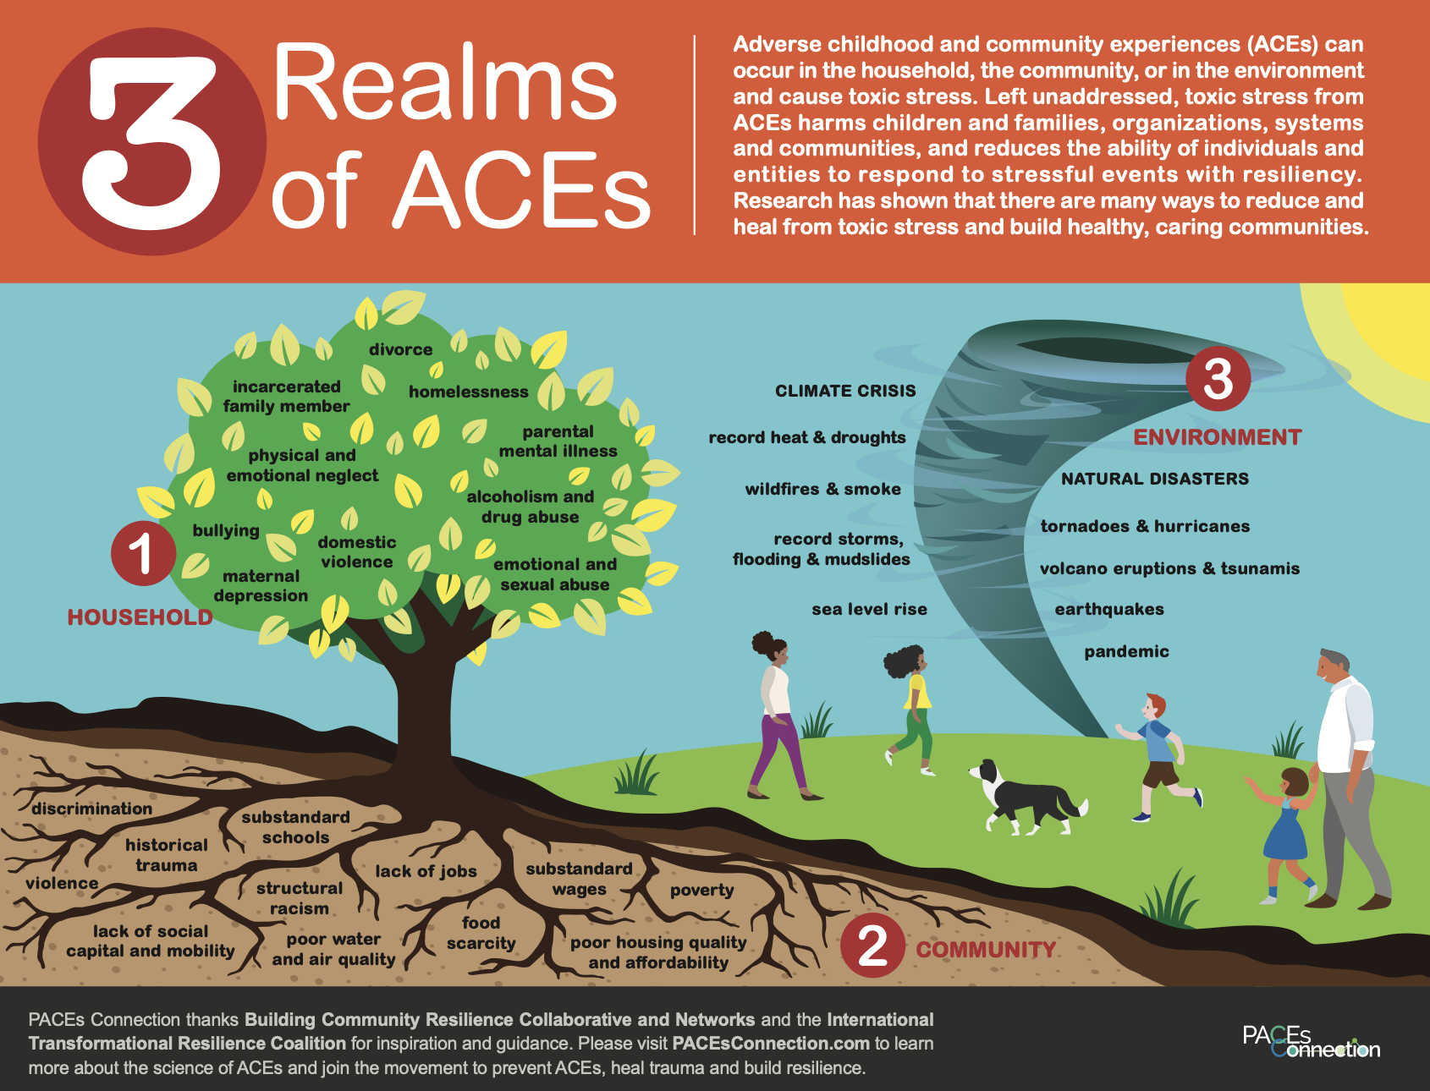
= The seed of generational adversity is the prolonged activation of stress response systems in the absence of protective relationships; toxic stress; relational poverty.
Source: https://www.pacesconnection.com/ws/Handouts_3RealmsACEs_EN.pdf
Notes:
The ACEs in these three realms - household, community, and environment - intertwine throughout people’s lives, and affect the viability of families, communities, organizations, and systems. The backside of this handout also covers five important findings from the ACEs study.
This graphic was created by PACEs Connection with inspiration and guidance from Building Community Resilience Collaborative and Networks and the International Transformational Resilience Coalition.

Slide 18
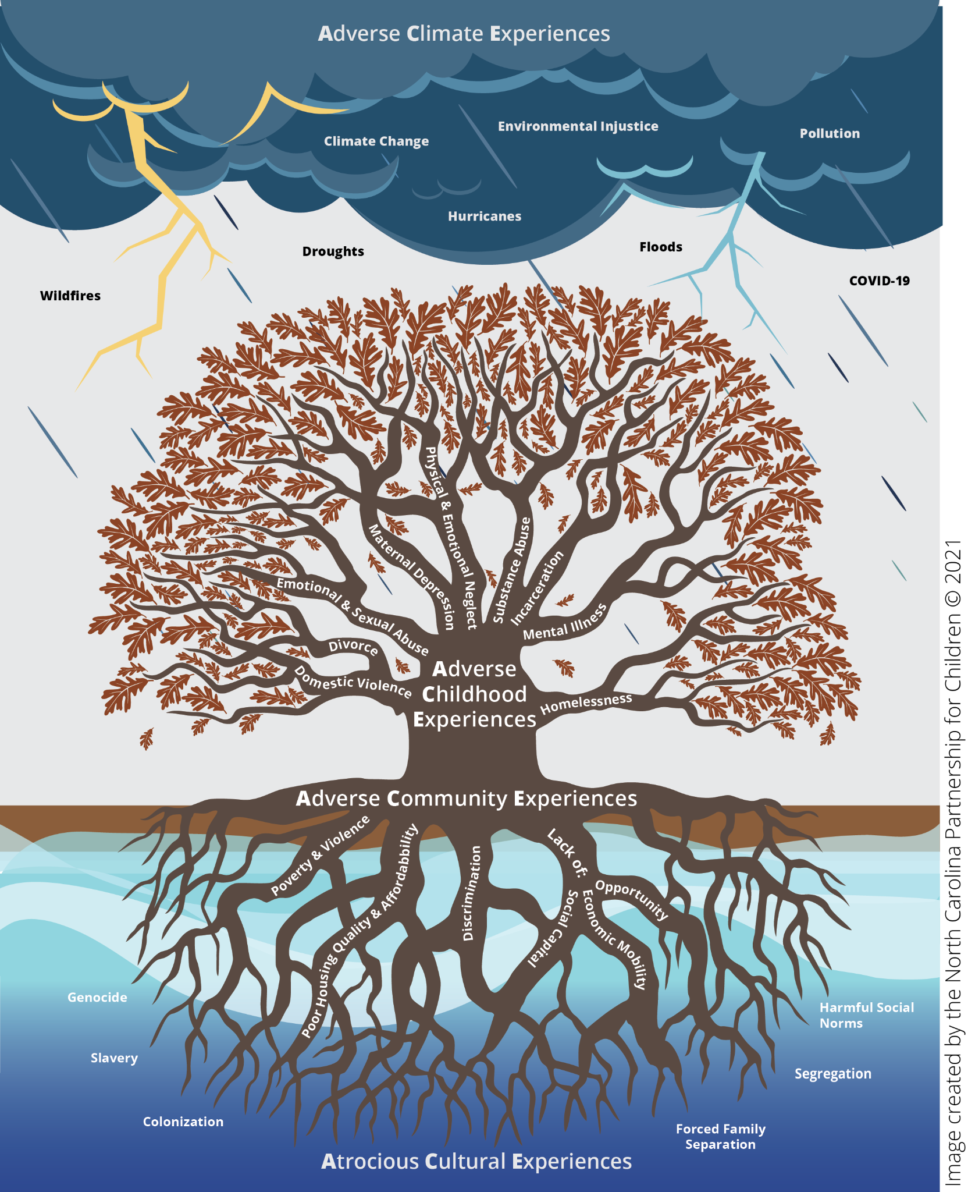
Adversity consists of a wide range of experiences or conditions that threaten the health and well-being of children, families, and communities.
Like resilience, adversity occurs across all levels of the social-ecological model. The understanding of adversity and its impacts on health and well-being continue to grow.
= The seed of generational strength is the reduction of the stress response systems through protective relationships; buffering supports; relational health
Source: https://www.smartstart.org/resilience-intro/resilience-home/
Notes:
Adversity consists of a wide range of experiences or conditions that threaten the health and well-being of children, families, and communities. Like resilience, adversity occurs across all levels of the social-ecological model. The understanding of adversity and its impacts on health and well-being continue to grow. The acronym ‘ACE’ can be defined in four primary ways: Adverse Childhood Experiences: Impact individual & interpersonal conditions. Examples include parental mental illness, substance abuse, interpersonal violence, homelessness, incarceration, divorce, death, emotional, physical, and sexual abuse, caregiver separation, and medical crisis.
Adverse Community Experiences: Impact population conditions. Examples include poverty, structural racism, community disinvestment, police violence, lack of affordable housing, lack of opportunity and economic mobility, discrimination, disconnected relationships, unemployment, and deteriorating built environments.
Adverse Climate Experiences: Impact community conditions. Examples include COVID-19, climate change, wildfires, droughts, hurricanes, earthquakes, floods, environmental injustice, and pollution.
Atrocious Cultural Experiences: Impact macro and socio-historical conditions. Examples include slavery, genocide, colonization, segregation, forced family separation, removal of property, and other harmful social norms such as low sense of political and social efficacy and mistrust.
Adversity consists of a wide range of experiences or conditions that threaten the health and well-being of children, families, and communities. Everyone is at risk for adversity. Historical, social, environmental and economic environments can contribute to inequities in exposure to adverse childhood experiences.12 Without the presence of protective factors and resilience strategies, both individual and multiple ACEs contribute to chronic stress and trauma for both individuals and communities across generations.

Slide 19
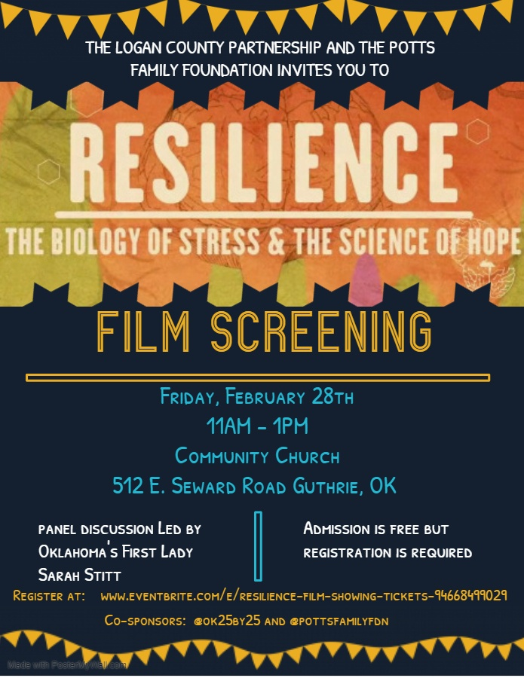
Partner Resource Sharing: Building Self-Healing Communities Free Resilience Film Screening & N.E.A.R. Science Training
Website: https://www.pacesconnection.com/g/raising-resilient-oklahomans
Email to request free Resilience Film or NEAR Science training: nearok@okstate.edu
Monthly virtual meetings - 4th Thursdays at 10am - Register Here for zoom link
Notes:
Interagency trainings on trauma, hope and resiliency increase awareness and build a common language and shared vision

Slide 20
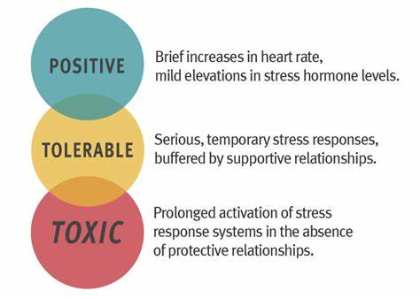
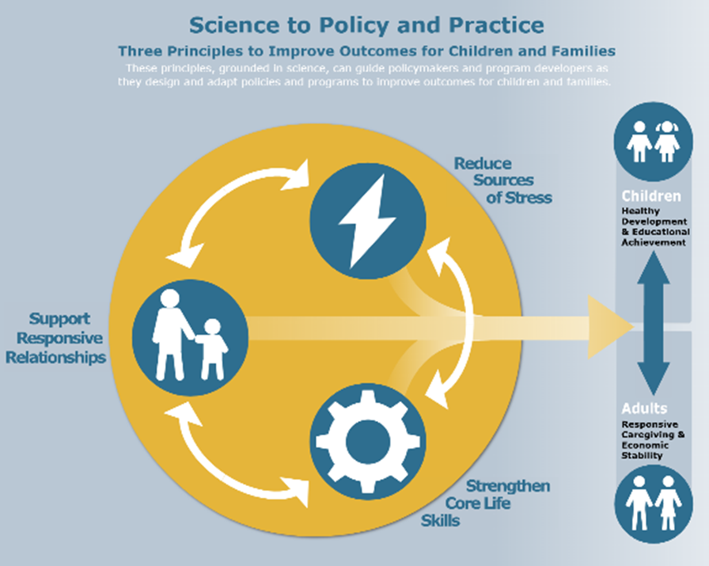
Buffering Supports turn Toxic Stress to Tolerable Stress
Source: Harvard’s Center on the Developing Child
Notes:
Buffering Supports

Slide 21
Science to
Policy and Practice:
Three Principles
to Improve Outcomes with Children and Families
Source: Harvard’s Center on the Developing Child
Notes:
Buffering Supports

Slide 22
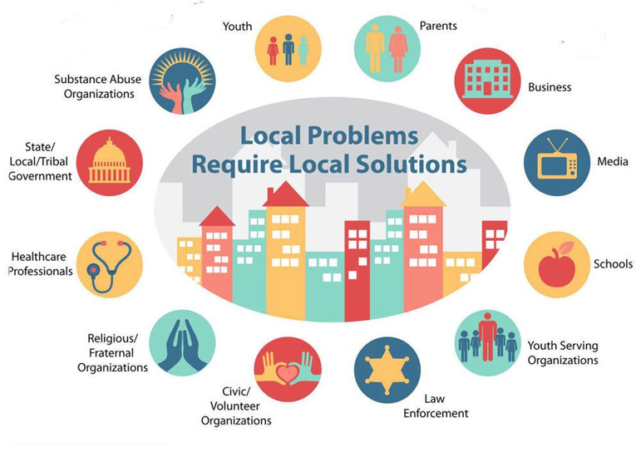
Relational Mapping: Local Solutions
Community Health Improvement Organizations (CHIOs)
and
Systems of
Care (SOC) Coalitions
Notes:
Working on reducing ACEs and increasing buffering supports is a unifying effort for communities. As you build your relational network, you can use this visual to start writing names of leaders within each sector that are willing to help.
It creates a very inclusive approach while also flexible based on the strengths of each community.

Slide 23
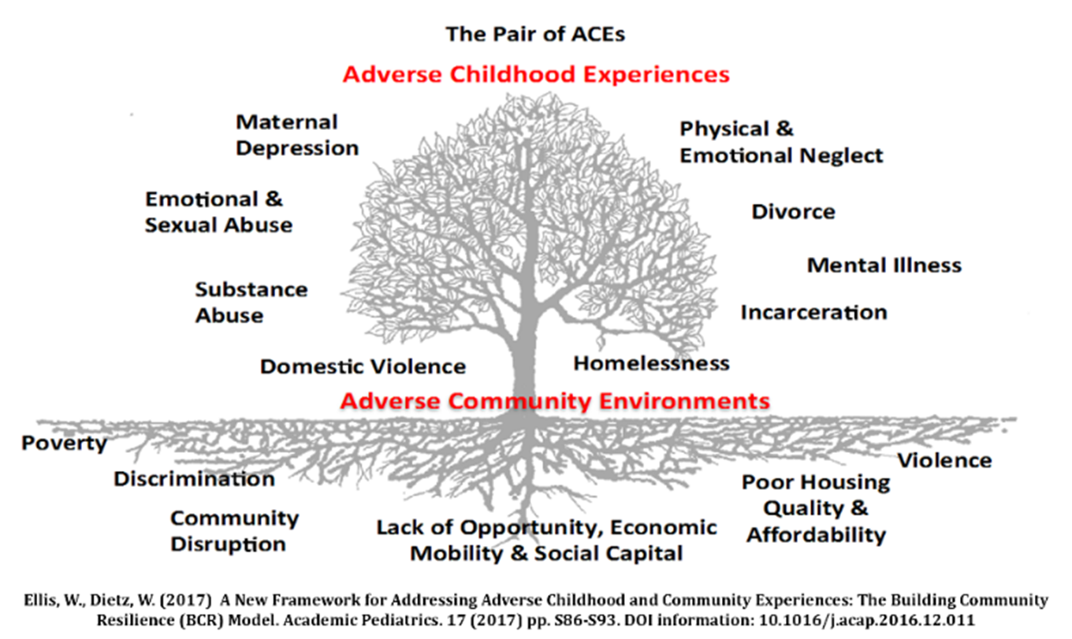
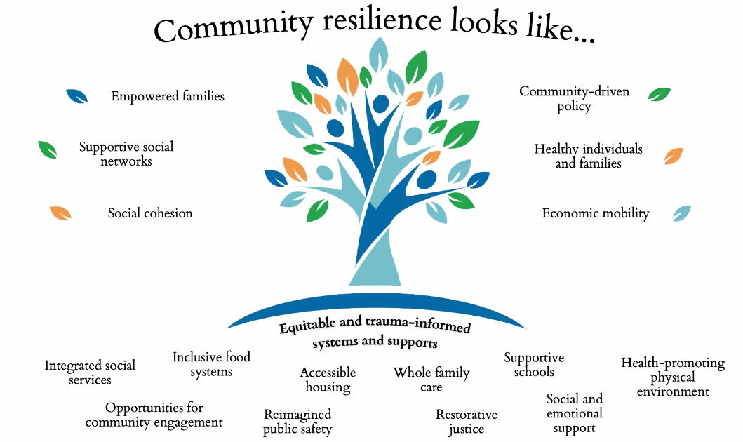
Shared Vision:
Realizing
Recognizing
Responding
Source: https://ccr.publichealth.gwu.edu/
Notes:
Shared Vision creates a unifying approach.

Slide 24
Individual & Family Adversities
Community & Structural Adversities
Family
Strengthening
Networks & Coalitions
Support
responsive
relationships & Strengthen core skills
Diversity e equity
belonging
& inclusion
Reduce
sources of
stress
(concrete needs)
Advance
leadership
skills &
co-design solutions
Handle With Care
& Multi-Tiered Systems of Support
Trauma- informed
policy & practices
Hope & Trauma
Interagency trainings
a
Social determinants
of health (SDOH) & Peer support groups
Parent/youth
advisory committees & family resource centers
Community
voice
Umbrella of Interagency Strategies: A Relational Framework for Strengthening Oklahoma Families & Communities Together
© Public Health Institute of Oklahoma, OK Parent Partnership Learning Community, OK Turning Point Council & OSDH
Notes:
Communities can utilize these relational strategies to complement efforts and build resilience.
Amber – to share local examples

Slide 25
Interagency Roadmap: Handle With Care
Family Story, HWC Overview, & Community Need
Law Enforcement (criteria & procedure)
Schools: Urban & Rural (response to notification)
Community & School-Based Behavioral Health (supports)
Community & School-Based Social Services (supports)
Community & School-Based Health Services (supports)
Notes:
Agenda - Slide 25 - 34 (OSSI rep/Gary Shelton)

Slide 26
First responders often walk away from a 911 call wishing they could do more for the kids… Other than a child welfare referral or the 988 Mental Health Lifeline
https://988oklahoma.com/what-is-988/
A HWC Notification “passes the baton” effectively
Notes:
A significant number of emergency 911 calls have children who are witnesses to a traumatic event without any follow-up support.
Keep in mind, when law enforcement is being called into a home. It is likely that the parents as well as the children of the home have experienced adverse childhood experiences. This also impacts how fully grown adults interact with law enforcement.

Slide 27
Multiple Positive Outcomes and Benefits:
Reduces Law Enforcement Contact
Absenteeism
Suspension
Expulsion
Truancy
Drop out
Contact with the law
Incarceration
Notes:
Buffering supports to prevent toxic stress

Slide 28
How does it work?
HWC Notice Criteria:
Was a child/teen present at the scene?
Plain and Simple:
A child/teen present at the scene meets the criteria of sending a HWC Notice.
Notes:
Whenever there is a child/youth at a scene, that meets the criteria for a Handle With Care notice. Plain and simple.

Slide 29
HWC Notice Procedure
For each child/youth, the Officer asks for
Name:
Age:
School:
The Officer sends an email to the designated school/county email:
“The child referenced has potentially experienced a traumatic event in the last 24 hours and could exhibit academic, emotional, and/or behavioral needs as a result of exposure to a traumatic event.
Please observe and handle him/her with care. For more information, go to www.handlewithcareok.org”
*Sample Directive Policy and Sample MOUs available on website
Notes:
name, age and school
email to designated school/county email

Slide 30
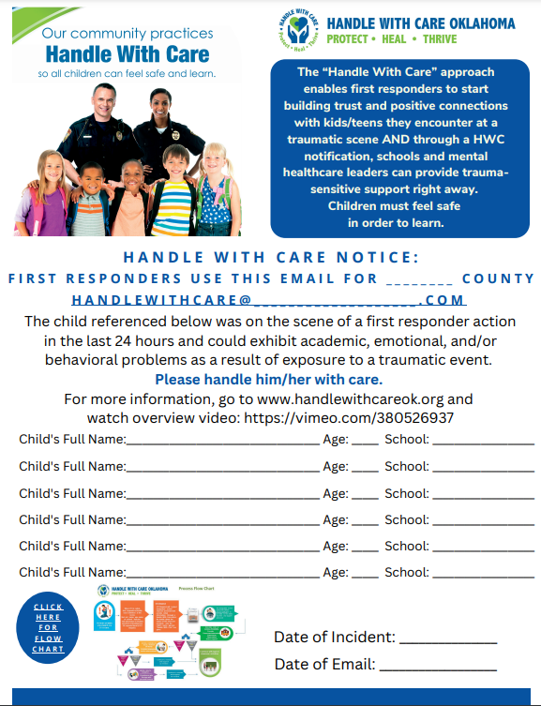
What does the HWC notice say?
HWC Notice Sample:
*Sample Directive Policy and
Sample MOUs available on website
Notes:
sample notice for educational purposes

Slide 31
3 Simple Steps for Handle With Care
First Responder responds to a 911 call where a school-age child/teen is a victim, witness, or bystander to a serious crime, traffic accident, arrest, or other.
First Responder makes a HWC notification via e-mail to school/child care agency: three words “Handle With Care” along with the name, age and school are included.
School district/daycare helps provide trauma-sensitive interventions, counseling and/or social services to student in crisis, the following school day, as needed.
Notes:
3 simple steps

Slide 32
Video for Law Enforcement: “Safeguarding Children of Arrested Parents”
Source: https://handlewithcaremd.org/law-enforcement-protocol.php https://www.youtube.com/watch?time_continue=386&v=ir2xA6XniSA&feature=emb_logo
Notes:
Watch 17 minute video with law enforcement: https://youtu.be/ir2xA6XniSA
Law Enforcement Resource link:
https://www.traumainformedmd.com/lawenforcement.html#/

Slide 33
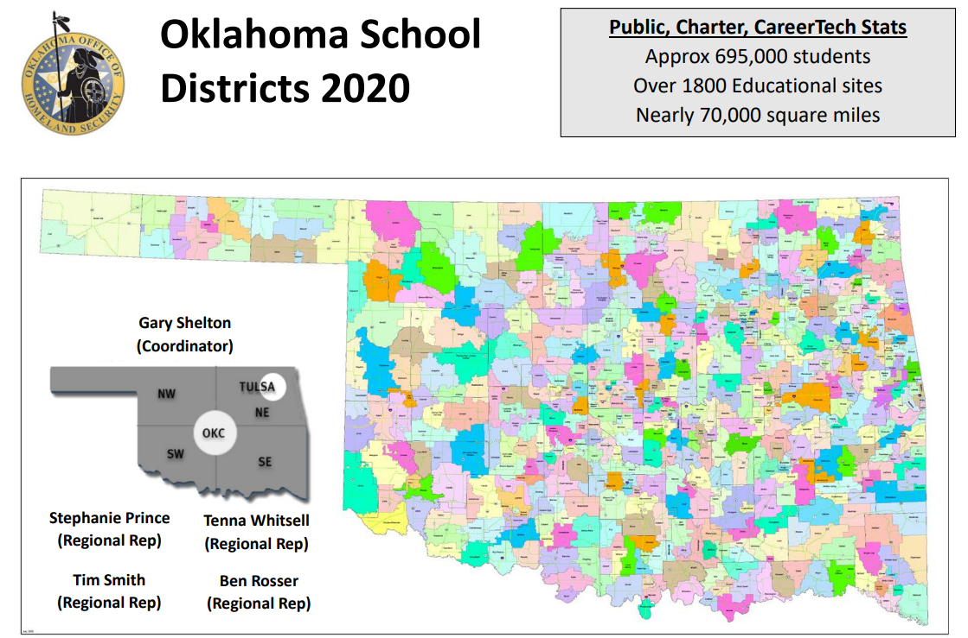
Resources for Oklahoma Law Enforcement: Oklahoma School Security Institute (OSSI)
Email OSSI, Gary Shelton: Gary.Shelton@dps.ok.gov
Website :https://oklahoma.gov/homeland-security/school-security/training.html
Enroll: https://oklahoma.gov/homeland-security/school-security/training/training-catalog.html
Notes:
Law Enforcement Resource link:
https://www.traumainformedmd.com/lawenforcement.html#/

Slide 34
Resources for Oklahoma Law Enforcement: Crisis Intervention Training (CIT)
Email CIT Trainer, Cory Sutton: cory.sutton@odmhsas.org
Website :https://oklahoma.gov/odmhsas/recovery/criminal-justice/cit.html
Enroll: https://www.ok.gov/cleet/CLEET_Training/Continuing_Education_-_Classroom_Training/
Notes:
Law Enforcement Resource link:
https://www.traumainformedmd.com/lawenforcement.html#/

Slide 35
Interagency Roadmap: Handle With Care
Family Story, HWC Overview, & Community Need
Law Enforcement (criteria & procedure)
Schools: Urban & Rural (response to notification)
Community & School-Based Behavioral Health (supports)
Community & School-Based Social Services (supports)
Community & School-Based Health Services (supports)
Notes:
Agenda

Slide 36
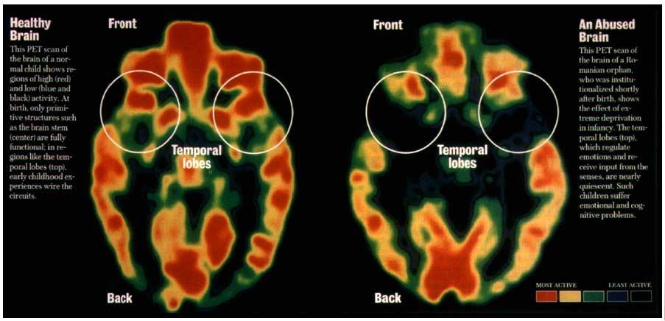
What happens when a child has unaddressed trauma?
Turns off the learning switch!
Notes:
TRAUMA TURNS OFF THE LEARNING SWITCH
These experiences in childhood can lead to a cascade of social, emotional and academic difficulties.
As students get older, exposure to traumatic experiences can also lead to the adoption of self-medicating behaviors such as substance abuse, smoking, and overeating.
All of these responses to traumatic events can interfere with a child’s ability to learn at school.

Slide 37
What does that look like in the classroom?
Childhood Trauma and Classroom Behavior
A traumatized child sees the world as a dangerous place, including the school. Unfortunately, many adopt behavioral coping mechanisms that can frustrate educators and evoke exasperated reprisal.
Reactivity
Impulsivity
Aggression
Defiance
Withdrawal
Perfectionism
Notes:
Children who suffer trauma are more likely to interpret people’s expressions as anger.
These reactions by the educator both strengthen expectations of confrontations and danger and reinforce a negative self-imagine.
To avoid reminders of the trauma, traumatized children adopt strategies (consciously or unconsciously) such as social withdrawal, aggressiveness, or substance abuse.
Encountering perceived threat leads to hyperarousal
Hyperarousal: physiological/emotional response to danger that prepares the flight, fight, or freeze response
Hypervigilance to danger interferes with regulation of emotion and accurate appraisal of a situation
Non threating stimuli can appear threatening
Triggers may appear positive to others.
Like a needle on a record player, complex trauma wears a groove in the brain. So when something non-threatening happens that reminds us of a traumatic incident, our bodies replay the traumatic reaction—mobilizing us to either run from or fight the threat, while shutting down other systems that help us think and reason. If this happens over and over, we become more easily triggered into that fear response mode, never giving our bodies time to recover. After awhile, as we adapt to this chronic triggering, our behavior can seem crazy or rude when taken out of the context of trauma.

Slide 38
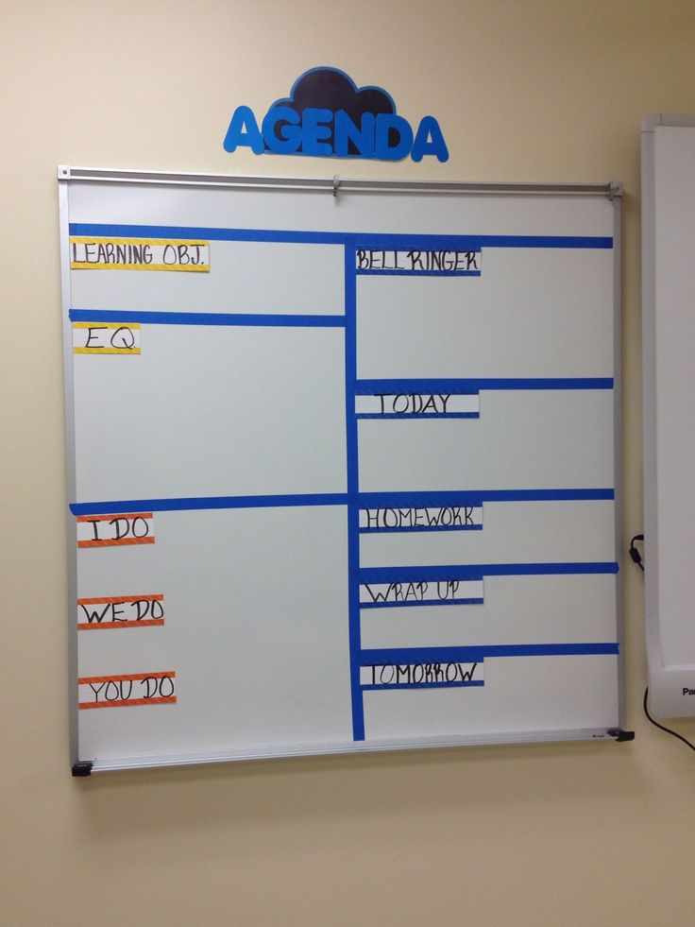
How Can Schools Respond to HWC Notifications? Individual Interventions
90% of children who have a Handle With Care notice can be supported with simple interventions, like snack/change of clothes/rest.
Notes:
90% of children who have a Handle With Care notice can be supported with simple interventions, like snack/change of clothes/rest.

Slide 39
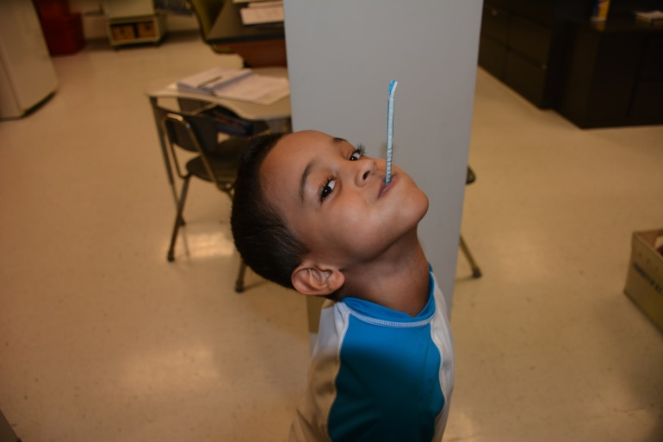
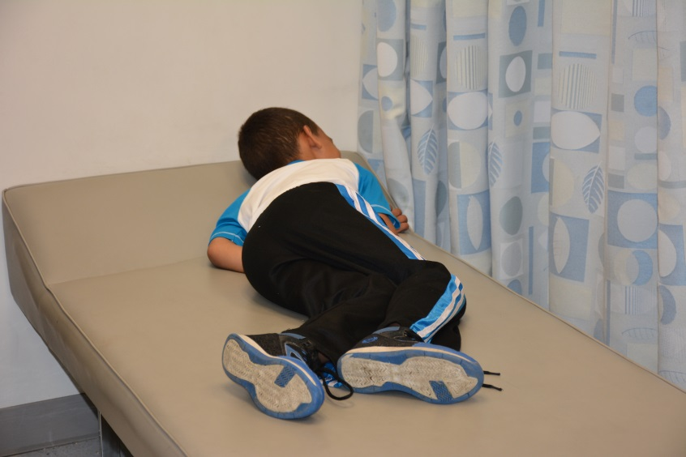
School Response to HWC Notification:
Individual Academic Interventions
Postpone
testing
Rest
IEP
Retesting
Notes:
Rest
Retest
Postpone testing
IEP

Slide 40
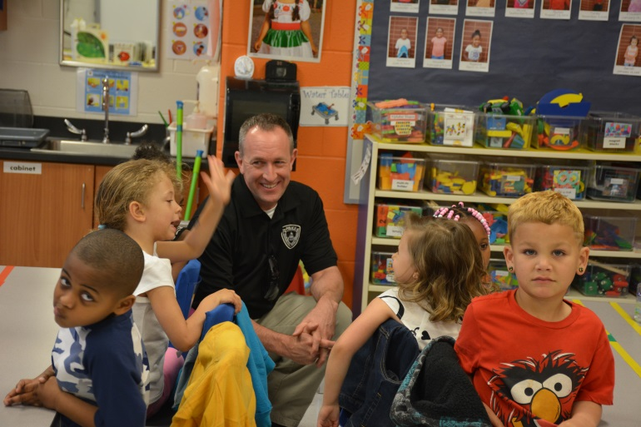
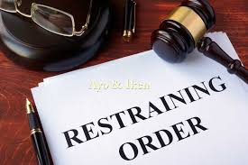
School Response to HWC Notification: School Interventions
Thumbs Up
LE visiting classroom
Therapy Dogs
Notes:
Thumbs up
Mentors
Therapy Dogs
LE Officers visiting school
Fostering closer relationships
Classroom interventions

Slide 41
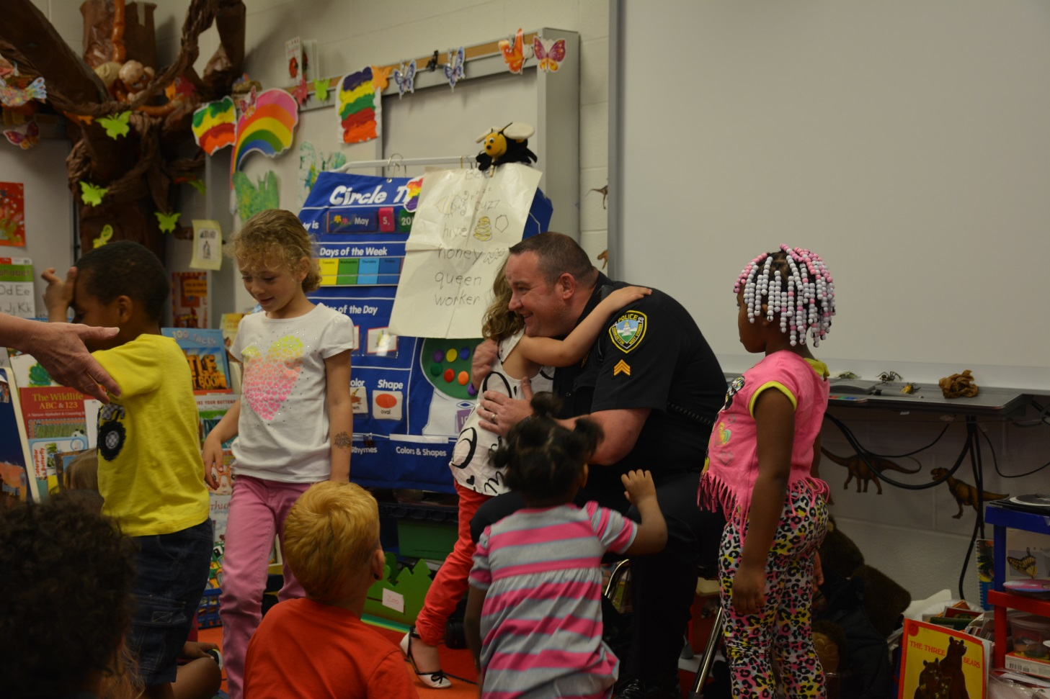
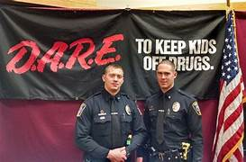
School Response to HWC Notification: Building Relationships with Law Enforcement
Notes:
Pick one day a week and have a school lunch. Pick a school who doesn’t have a resource officer.

Slide 42
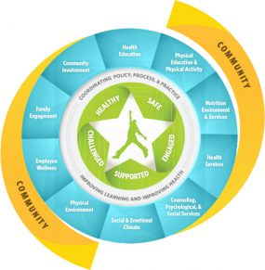
Building Safe and Healthy Schools:
“Schools play a critical role in promoting the health of young people and helping them establish lifelong healthy behaviors. Research shows that healthy schools can help improve students' academic performance and overall health. Our goal is to serve the whole child, including strategies and resources for all students to be safe, healthy, challenged, engaged, and supported.”
School Resources:
https://sde.ok.gov/school-safety-and-security
https://sde.ok.gov/safe-and-healthy-schools
https://sde.ok.gov/counseling https://sde.ok.gov/ok-aware https://sde.ok.gov/school-based-mental-health
Notes:
Benefits to Trauma Sensitive School (Oehlberg, 2008)
Improved academic achievement and test scores.
Improved teacher sense of satisfaction and safety in being a teacher.
Improved retention of new teachers.
Reduction of student behavioral outbursts and referrals to the office.
Reduction of stress for staff and students.
Reduction in absences, detentions, and suspensions.
Reduction in student bullying and harassment.
Lincoln High School is an alternative school in Walla Walla, WA. It’s where they put the “throw-away” kids.
Almost every city has one of these schools. The first year after principal Jim Sporleder implemented trauma-informed practices, suspensions dropped 85% and expulsions went down 40%.
By the 2012 school year, suspensions dropped another 50%, and there were no expulsions. And their academic scores and graduation rates went up. The kids know they’re safe and loved; they say the school is their family. They’ve done their own ACE survey, and found that their average ACE score is 5.
This story has touched a nerve. Since it was published in 2012, it’s gone viral twice, and has had more than 690,000 page views.

Slide 43
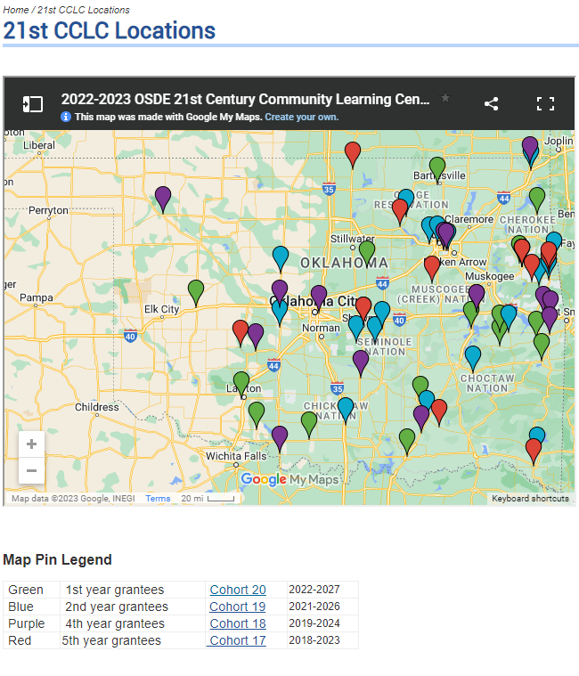
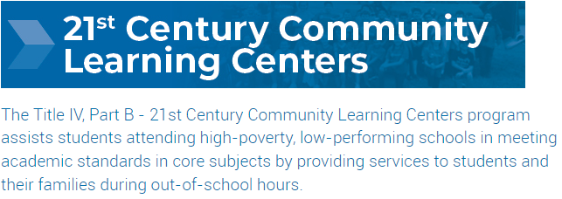
https://sde.ok.gov/21cclc
Notes:
Benefits to Trauma Sensitive School (Oehlberg, 2008)
Improved academic achievement and test scores.
Improved teacher sense of satisfaction and safety in being a teacher.
Improved retention of new teachers.
Reduction of student behavioral outbursts and referrals to the office.
Reduction of stress for staff and students.
Reduction in absences, detentions, and suspensions.
Reduction in student bullying and harassment.
Lincoln High School is an alternative school in Walla Walla, WA. It’s where they put the “throw-away” kids.
Almost every city has one of these schools. The first year after principal Jim Sporleder implemented trauma-informed practices, suspensions dropped 85% and expulsions went down 40%.
By the 2012 school year, suspensions dropped another 50%, and there were no expulsions. And their academic scores and graduation rates went up. The kids know they’re safe and loved; they say the school is their family. They’ve done their own ACE survey, and found that their average ACE score is 5.
This story has touched a nerve. Since it was published in 2012, it’s gone viral twice, and has had more than 690,000 page views.

Slide 44
The purpose of the AWARE grant is to build or expand the capacity of State Educational Agencies in partnership with State Mental Health Agencies and Local Education Agencies to 1) increase awareness of mental health issues among students 2) provide training to school personnel and other adults who interact with students to detect and respond to mental health issues; and 3) connect students, who may have behavioral health issues, serious emotional disturbance or serious mental illness, and their families to needed services.
https://sde.ok.gov/aware-goals-and-objectives
Notes:
Benefits to Trauma Sensitive School (Oehlberg, 2008)
Improved academic achievement and test scores.
Improved teacher sense of satisfaction and safety in being a teacher.
Improved retention of new teachers.
Reduction of student behavioral outbursts and referrals to the office.
Reduction of stress for staff and students.
Reduction in absences, detentions, and suspensions.
Reduction in student bullying and harassment.
Lincoln High School is an alternative school in Walla Walla, WA. It’s where they put the “throw-away” kids.
Almost every city has one of these schools. The first year after principal Jim Sporleder implemented trauma-informed practices, suspensions dropped 85% and expulsions went down 40%.
By the 2012 school year, suspensions dropped another 50%, and there were no expulsions. And their academic scores and graduation rates went up. The kids know they’re safe and loved; they say the school is their family. They’ve done their own ACE survey, and found that their average ACE score is 5.
This story has touched a nerve. Since it was published in 2012, it’s gone viral twice, and has had more than 690,000 page views.

Slide 45
School Response to HWC Notification: What is a Trauma Sensitive School?
A trauma-sensitive school is one in which:
All students feel safe, welcomed, and supported;
Addressing trauma’s impact on learning on a school-wide basis is at the center of its educational mission;
A place where an on-going, inquiry-based process allows for the necessary teamwork, coordination, creativity and sharing of responsibility for all students; and
Where continuous learning is for educators as well as students.
Benefits to Trauma Sensitive School (Oehlberg, 2008)
Improved academic achievement and test scores.
Improved teacher sense of satisfaction and safety in being a teacher.
Improved retention of new teachers.
Reduction of student behavioral out-burst and referrals to the office.
Reduction of stress for staff and students.
Reduction in absences, detentions, and suspensions.
Reduction in student bullying and harassment.
Resource: https://safesupportivelearning.ed.gov/resources/trauma-informed-classrooms
Notes:
Benefits to Trauma Sensitive School (Oehlberg, 2008)
Improved academic achievement and test scores.
Improved teacher sense of satisfaction and safety in being a teacher.
Improved retention of new teachers.
Reduction of student behavioral out-burst and referrals to the office.
Reduction of stress for staff and students.
Reduction in absences, detentions, and suspensions.
Reduction in student bullying and harassment.

Slide 46
A program aimed at ensuring that children (birth to 18 years) who are exposed to violence receive appropriate interventions so they can succeed in school to the best of their ability.
FOCUS BEHAVE APPROPRIATELY LEARN
Notes:
helping kids succeed in school to the best of their ability

Slide 47
Interagency Roadmap: Handle With Care
Family Story, HWC Overview, & Community Need
Law Enforcement (criteria & procedure)
Schools: Urban & Rural (response to notification)
Community & School-Based Behavioral Health (supports)
Community & School-Based Social Services (supports)
Community & School-Based Health Services (supports)
Notes:
Agenda

Slide 48
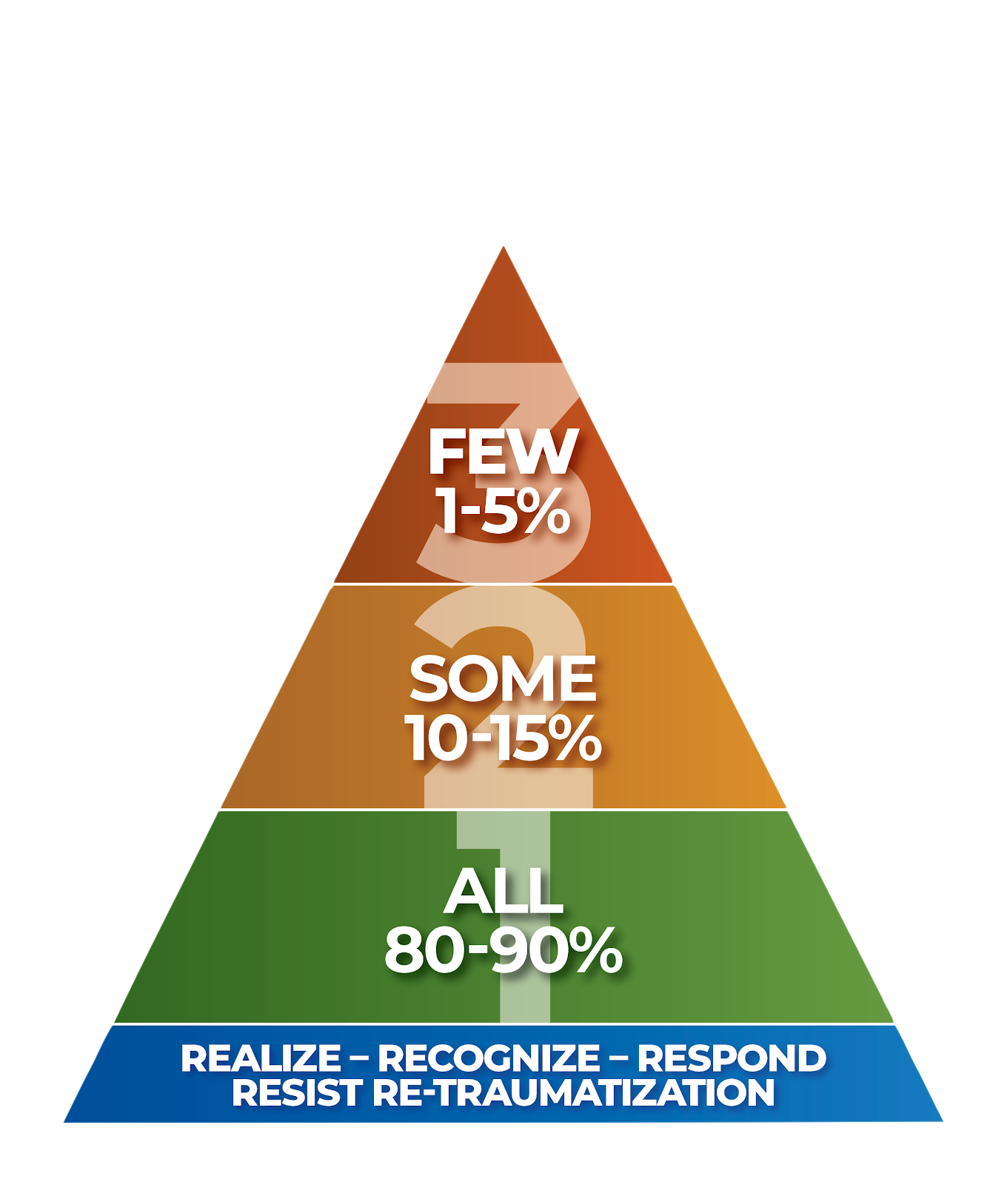
Multi-Tiered Systems of Support (MTSS) Approach:
Individualized Interventions
Few individualized, assessment-based
Intense, durable supports for high-risk behaviors
Targeted Interventions
Some identified as at-risk, high efficiency, rapid response
Universal Supports
All settings. Focus on prevention
Notes:
Multi-Tiered Systems of Support (MTSS)

Slide 49
Process Flow Chart
Click here for Overview Video
www.handlewithcareok.org
First responders on the scene identify each child/teen. Find out name, age, name of school/ daycare. This information is emailed directly to school/daycare OR reposted back to 911 dispatch.
911 Dispatch
911 Dispatch will contact designated school /daycare personnel and provide initial information through a Handle With Care notice. No details about the nature of the event are provided; only the child’s name , age and “Handle With Care” are given.
SCHOOL DISTRICT
The designated school personnel will then ensure notification is provided to the child’s teachers and support personnel.
SCHOOL
Children or teens are present at a traumatic event.
TEACHING STAFF & SCHOOL PERSONNEL
Provide: Classroom Interventions
Awareness Observation and/or Support
SCHOOL COUNSELOR, SOCIAL WORKER
OR NURSE
If Additional Support
IS
Needed
If Additional Support Is NOT
Needed
Provides assessment and/or interventions
If Additional Support
IS
Needed
If Additional Support Is NOT
Needed
Continue with typical classroom activities
Continue to monitor and support
as needed.
MENTAL HEALTH THERAPIST
Continue to monitor and support
as needed.
Provides on-site therapy with parental consent
Notes:
Process Flowchart Version 2: Printer friendly
Statewide Youth Mobile Crisis Line https://heartlineoklahoma.org/heartlineoklahoma.org-youth-crisis-mobile-response (833) 885-CARE (2273)

Slide 50
Statewide mental health supports for schools:
“Recently the Oklahoma State Legislature passed HB4106, which increases school-based partnerships between Certified Community Behavioral Health Centers (CCBHCs), certified ODMHSAS providers and school districts.
Currently, the ODMHSAS and the State Department of Education are working to establish guidelines to support local partnerships between CCBHC’s, certified ODMHSAS providers and school districts.”
Sample MOU: https://oklahoma.gov/content/dam/ok/en/odmhsas/documents/treatment/cyf/soc/MOU-Sample-HB4106.pdf
Email: Sr. Manager of School Based Initiatives – Mr. Butler: Marqus.Butler@odmhsas.org Sr. Prevention Programs Field Representative - Mrs. Brandi Gaither: brandi.gaither@odmhsas.org
Notes:
Behavioral Intervention and Support Services (BISS) Schools

Slide 51
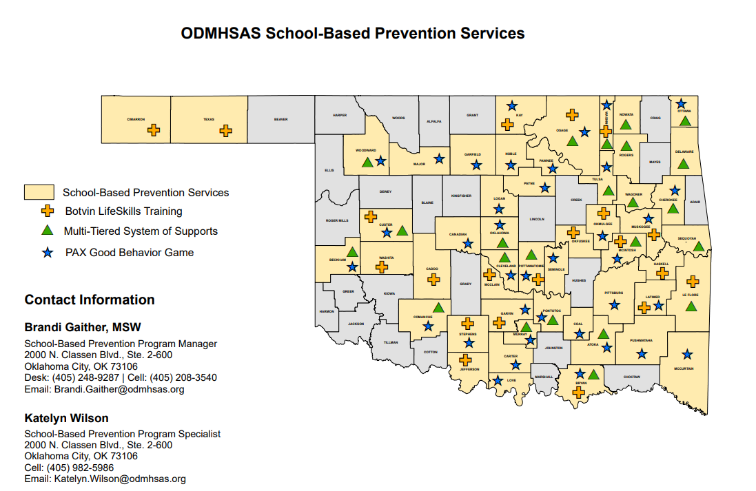
School-Based Prevention Services
Source: https://oklahoma.gov/odmhsas/prevention/schools.html

Slide 52
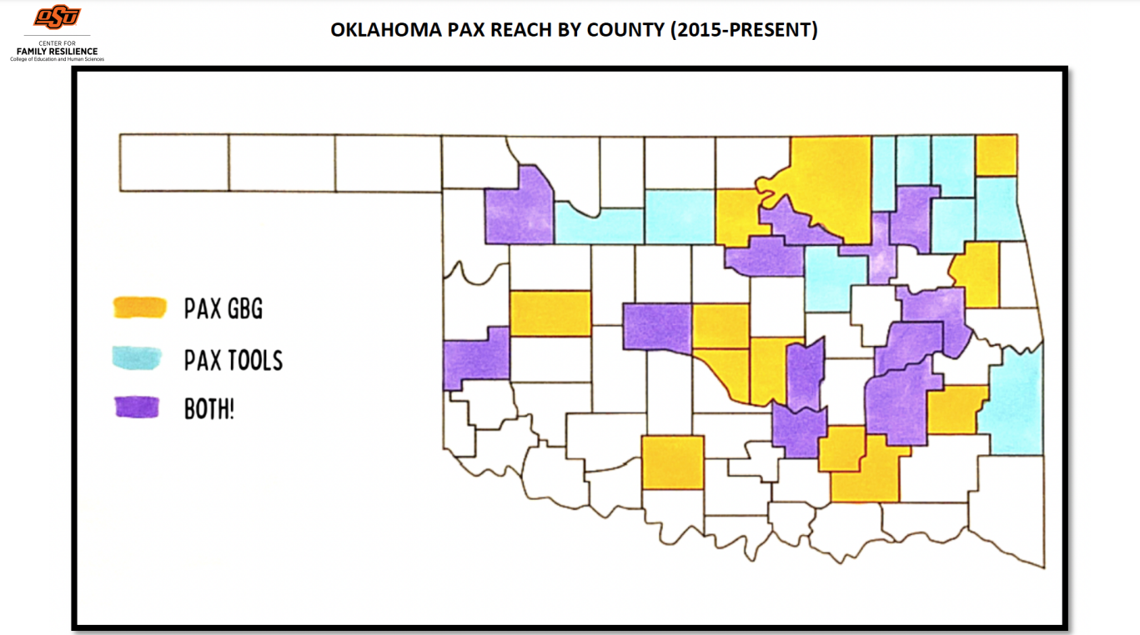
School-Based Prevention Services
Source: https://education.okstate.edu/research/centers/center-family-resilience/current-projects.html

Slide 53
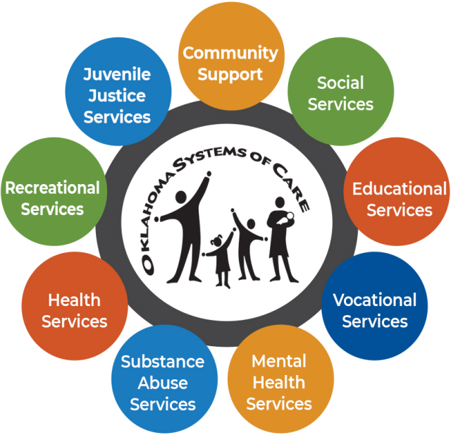
BISS is the flagship school-based project for the ODMHSAS Systems of Care Initiative.
Behavioral Intervention Services and Supports (BISS) in Schools
BISS works with local school administrators (teachers, principals, and school-based counselors) to support the emotional needs of youth, and provide educators with training to encourage and promote positive classroom behavior.
BISS is currently being implemented in 90 school sites across the state, with more sites being added each school year.
Website: https://oklahoma.gov/odmhsas/treatment/children-youth-treatment-services/systems-of-care.html
Notes:
Behavioral Intervention and Support Services (BISS) Schools

Slide 54
Interagency Roadmap: Handle With Care
Family Story, HWC Overview, & Community Need
Law Enforcement (criteria & procedure)
Schools: Urban & Rural (response to notification)
Community & School-Based Behavioral Health (supports)
Community & School-Based Social Services (supports)
Community & School-Based Health Services (supports)
Notes:
Agenda

Slide 55
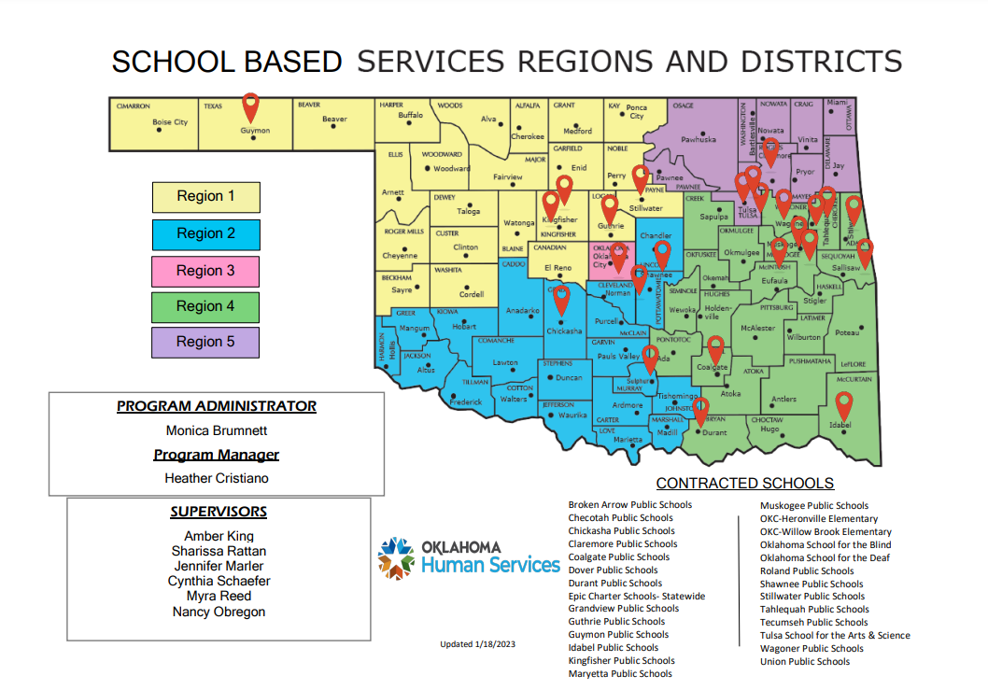
OKDHS Partnerships: School-Based Services
Through the partnership, a School-Based Specialist (SBS) is placed in the school with the dedicated purpose of providing a human service connection and support to the children and families served by the school, as well as the school’s teachers and administrators.
Website: https://oklahoma.gov/okdhs/services/foster/schoolbasedservices/sbshome.html
Application: https://oklahoma.gov/okdhs/services/foster/schoolbasedservices/application.html
Notes:
Need contact DHS – Brett Hayes or Deb Dobshire

Slide 56
OKDHS Partnerships: School-Based Services
The SBS connects students and their families to local and state resources that can offer help and hope for the family.
This compassionate and professional support helps students navigate out-of-classroom obstacles that would affect their success in the classroom and allows teachers to focus on teaching.
The SBS makes a significant impact on the well-being of their communities, improving outcomes and reducing risk factors for the students and families they serve.
Notes:
Need contact DHS – Brett Hayes or Deb Dobshire

Slide 57
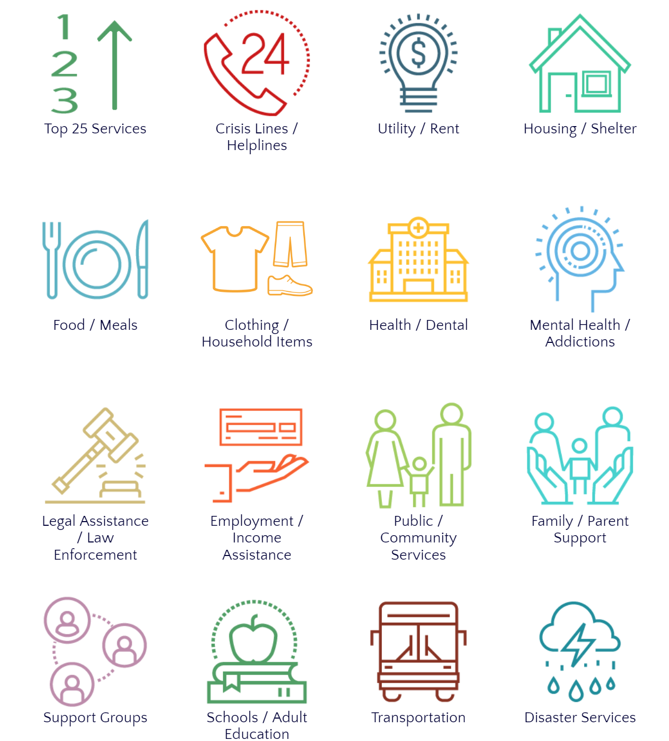
Are you OK? Oklahoma CARES: Call 211
Many things in life can leave a person in crisis, isolated and feeling overwhelmed: disease outbreak, aftermath of a storm, loss of a job, abuse at home, mental health struggles, bills higher than earnings. You Are Not Alone Anymore. Talk to Someone Who Cares & Knows Where to Go for Help. CALL 211 HEARTLINE NOW.
TEXT YOUR ZIP CODE TO 898-211 We provide compassionate, non-judgmental listening, as well as resources and support to get you back on your feet. Youth Helpline: 1-833-885-CARE (2273)
Parent Helpline: 1-877-271-7611
Need to Talk? 1-800-273-TALK (8255) or 988 Emergency: Dial 911 Like these resources? Please take a picture & share with a friend. If friend is in need, request consent & call together on speaker. Want to help and give back? Volunteer with 211 or your local charity.
Disability Services
Crisis Lines/ Helplines
Utility / Rent
Housing / Shelter
Clothing / Household Items
Mental Health
Substance Use Treatment
Food / Meals
Health / Dental Family Planning
Mental Health Substance Use Treatment
Legal Assistance Law Enforcement
Employment / Income Assistance
Violence Prevention Public / Community Services
Family / Parent
Guardian Support
Support Groups
Schools / Adult Education
Transportation
Disaster Services
Notes:
Post in public bathrooms

Slide 58
¿Estás OK? Oklahoma le IMPORTAS: Llama al 211
Muchas cosas en la vida pueden dejar a una persona en crisis, aislado, abrumado: brote de enfermedad, los daños después de una tormenta, la pérdida del empleo, abuso en el hogar, problemas de salud mental, las facturas más altas que el sueldo.
Ya no estás solo(a).
Habla con alguien que se preocupa y sabe dónde buscar ayuda.
LLAMA AL 211 HEARTLINE AHORA ENVÍA TU CÓDIGO POSTAL POR MENSAJE DE TEXTO AL 898-211
Brindamos un oído para escuchar con compasión y sin prejuicios, así como recursos y apoyo para que pueda recuperarse. Línea de ayuda para jóvenes: 1-833-885-CARE (2273)
Línea de ayuda para padres de familia: 1-877-271-7611
¿Necesito hablar?: 1-800-273-TALK (8255) or 988
Emergencia: Marca 911
¿Te gustan estos recursos? Tómales una foto y compártelos con una amistad. Si un amigo necesita una petición consentimiento y convoca en altavoz. ¿Quieres ayudar y devolver? Voluntario con 211 o a caridad local.
Servicios para discapacitados
Líneas de ayuda en crisis / Líneas de ayuda
Servicios / Renta
Vivienda / Refugio
Comida / Alimentos
Ropa / Artículos para el hogar
Salud / Dental Planificación familiar
Mental Health
Substance Use Treatment
Salud mental / Tratamiento en el uso de sustancias
Asistencia legal / Cumplimiento de la ley
Empleo / Asistencia con ingresos
Prevención de la violencia Servicios públicos / Comunitarios
Apoyo familiar / para padres
Grupos de apoyo
Escuelas / Educación para adultos
Transporte
Servicios en caso de desastre
Notes:
Post in public bathrooms

Slide 59
Interagency Roadmap: Handle With Care
Family Story, HWC Overview, & Community Need
Law Enforcement (criteria & procedure)
Schools: Urban & Rural (response to notification)
Community & School-Based Behavioral Health (supports)
Community & School-Based Social Services (supports)
Community & School-Based Health Services (supports)
Notes:
Agenda

Slide 60
OSDH Community Outreach: Healthy Schools Whole School, Whole Community, Whole Child (WSCC)
“Students are most influenced to lead healthy and productive lives when the schools, parents, and other community groups work collaboratively. Each of these groups has unique roles for accessing students, identifying and sharing resources, and impacting health behaviors of children and youth.
Healthy & Fit School Advisory Committees can serve as a catalyst for systemic changes in schools to promote student health and educational outcomes and can develop and implement school wellness policies and health enhancing programs which foster family and community support and involvement.”
Resource: https://oklahoma.gov/health/health-education/community-outreach/community-development-services/school-health.html
Notes:
Need contact DHS – Brett Hayes or Deb Dobshire

Slide 61
Buffering Supports turn Toxic Stress to Tolerable Stress
Source: Harvard’s Center on the Developing Child
Notes:
Buffering Supports

Slide 62
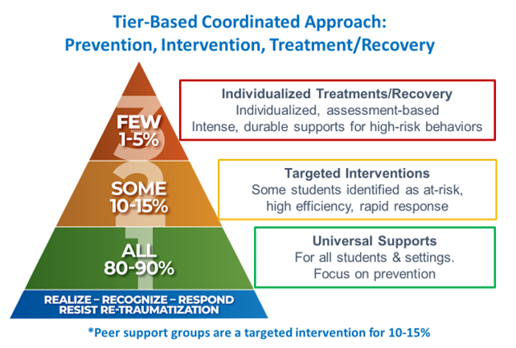
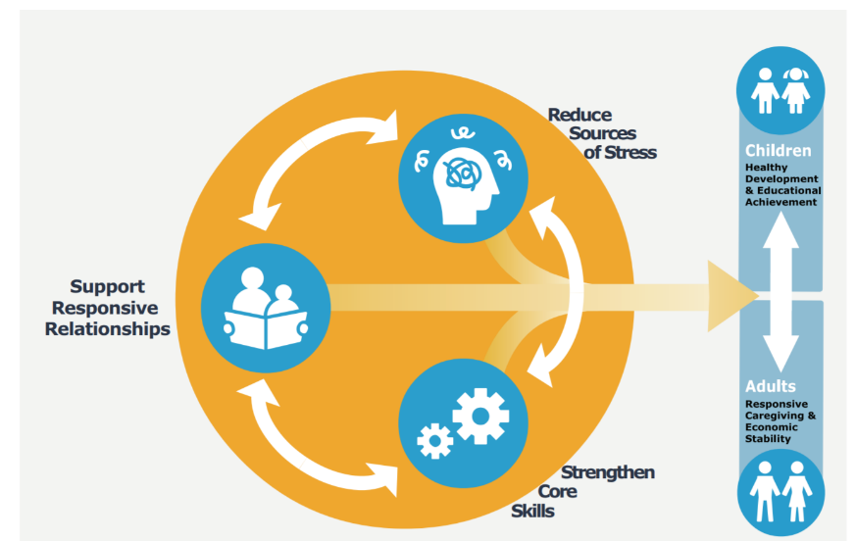
Social Drivers of Health
Peer Support Groups:
Address SDOH Needs, Improve Social Connection & Life Skills 1) Reducing Sources of Stress/Removes Barriers for Participation provide weekly family meal, childcare, stipend, and transportation if needed
2) Supporting Responsive Relationships and Environments 8–12 people meet weekly for 16+ weeks to build authentic relationships that last beyond graduation
3) Strengthening Core Life Skills Over 4-5 months, two trained facilitators use a curriculum that builds executive functioning skills in 11 domains
Sample SDOH Assessment (pre and post) peer support group to measure progress: https://fs27.formsite.com/a34qO0/karddnch4j/index.html
Notes:
Peer support groups addresses the three principles by:
Providing a family meal, childcare, stipend, and transportation
Facilitating 8–12 people who meet weekly for 18 weeks to build authentic relationships that last beyond graduation
Using a trauma-informed curriculum with two trained facilitators that build executive functioning skills in 11 different areas of life

Slide 63
Parent Advisory Committees
community voice
advancing leadership skills among populations experiencing health disparities
Resource: https://handlewithcareok.org/parent-advisory-committee-training/
Notes:
Need contact DHS – Brett Hayes or Deb Dobshire

Slide 64
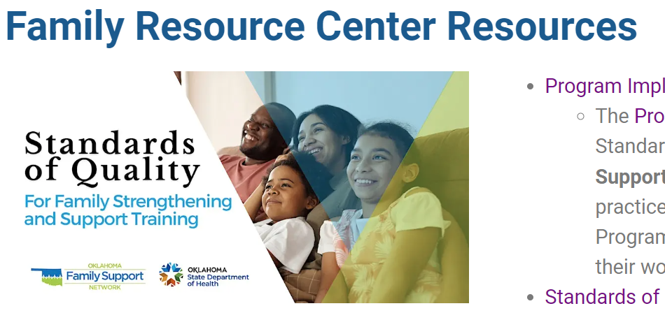
community schools
resource hubs
one-stop shops
Resource: https://handlewithcareok.org/family-resource-center-resources/
Notes:
Need contact DHS – Brett Hayes or Deb Dobshire

Slide 65
Goal…. All school districts collaborate with their local first responders to implement HWC, so all children can feel safe and learn.
Notes:
Goal

Slide 66
How is Handle With Care beneficial for children & youth?
Improves early relational health & trust
Improves positive school climate
Improves youth mental health
Increases attendance
Increases academic success
Improves positive life trajectory
Decreases negative behavioral referrals
Decreases truancy
Decreases suspensions
Decreases expulsions
Decreases contact with the law
Notes:
Benefits for Communities

Slide 67
How is Handle With Care beneficial for each community?
Empowers local communities to take initiative to address trauma
Increases communication and coordination across agencies to improve community outcomes
Builds trust with child and family
Promotes problem-solving with family to increase family, youth, child, and infant stability
Low-cost
Notes:
Benefits for Communities

Slide 68
How to advance Handle With Care Oklahoma in your community?
Show the Roll Call Video at your next city council meeting
Share the process flow chart
Share the HWC notification form
Town/law enforcement/school create an email: handlewithcare@yourtown.gov monitored by local multidisciplinary team (MDT)
Law enforcement chief/sheriff/tribal marshal utilize sample directive
Schools and law enforcement sign sample partnership agreement
Click or Scan QR code
Notes:
Action Pack for Implementation

Slide 69
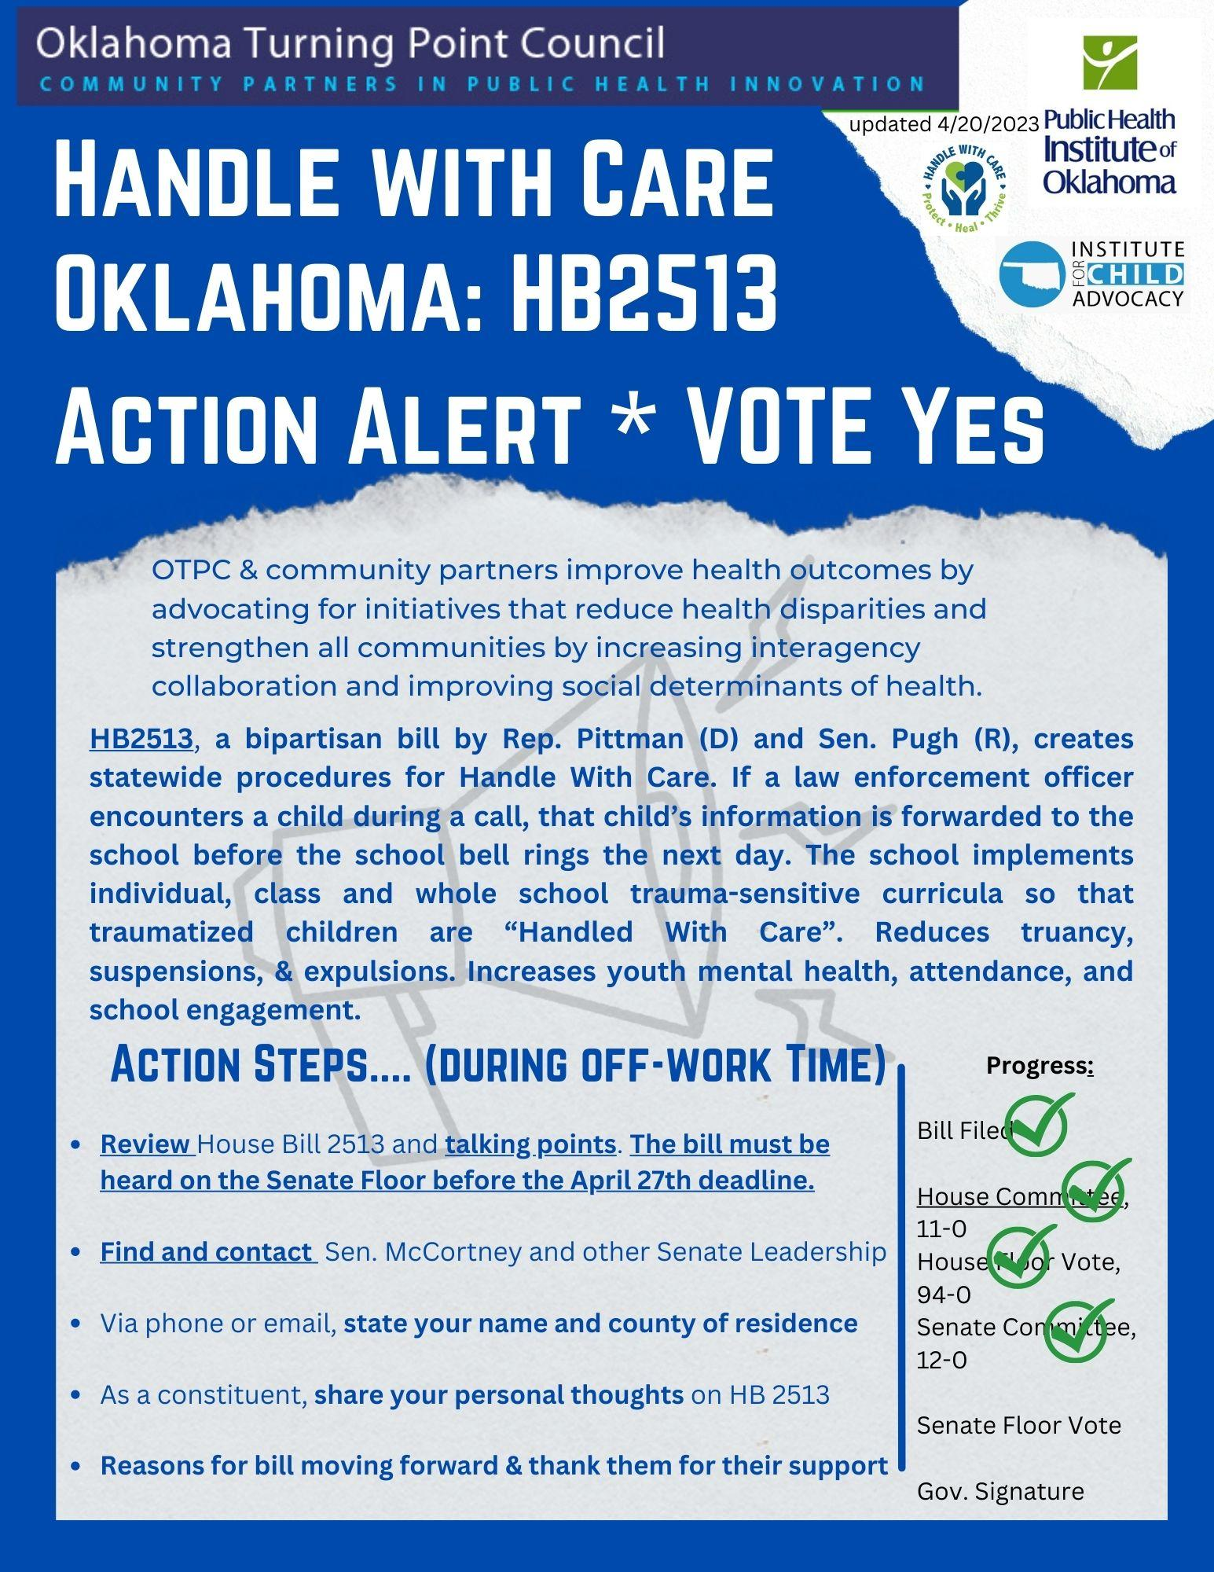
Policy Action Steps to Advance HWC OK Statewide:
Link to HWC Advocacy Flyer
2018-2022: grassroots efforts in over 35 counties
July - Submitted Interim Study application with bipartisan support
July/August – Interim Study approved/prep and confirm speakers
Oct. 20th at 10am – Presentation at State Capitol
December 9th – Submitted Legislation topic; draft legislation
January 18, 2023 – Submitted 1st version of legislation; HB 2513
February 28, 2023 - Passed Common Education House Committee, Vote 11-0
March 2023 – Passed House Floor, Vote 94-0
April 2023 - Passed Senate Education Committee, Vote 12-0; passed Senate Floor, Vote 42-0
June 2023 - Pocket-vetoed by Governor
Continue to build consensus with community coalitions and first responders to have consistent law enforcement notification protocol to schools when child/teen is at a traumatic scene
Notes:
policy in Oklahoma

Slide 70
Perspective Shift
Conventional
People are bad.
People need to be punished.
What is wrong with you?
Trauma-informed
People are suffering.
People need to learn how trauma impacts a child’s and adult’s development.
What happened to you?
Resiliency-informed
People are resilient.
People need to learn how skills of well-being can reduce suffering.
What is right about you?
What are your strengths?
Notes:
Perspective Shift

Slide 71
Evaluation & Feedback
Q&A Group Discussion
Contact Info: info@handlewithcareok.org

Slide 72
Additional Slides
Notes:
https://pacesconnection.libguides.com/resourcecenter/pacesscience/handouts

Slide 73
Free Workshop Series: “Creating Connections to Support Oklahoma’s Youth”
Resilience Film, N.E.A.R. Science Trainings, Handle With Care OK training, Multi-Tiered Systems of Supports, Multidisciplinary Team Action Planning, & HWC OK Train the Trainer
Notes:
Interagency trainings on trauma, hope and resiliency increase awareness and build a common language and shared vision

Slide 74
Free Workshop Series: “Creating Connections to Support Oklahoma’s Youth”
ACEs Primer, Resilience Film, N.E.A.R. Science Trainings, Handle With Care OK trainings, Multi-Tiered Systems of Supports, Multidisciplinary Team Action Planning, and HWC Train the Trainer
Notes:
Interagency trainings on trauma, hope and resiliency increase awareness and build a common language and shared vision

Slide 75
For More Resources, Toolkits and Templates:
Handle With Care Toolkit for Law Enforcement: https://handlewithcaremd.org/law-enforcement-protocol.php Handle With Care Community Action Pack: https://salud-america.org/handle-with-care-full-action-pack/
Sample of statewide website from West Virginia: http://www.handlewithcarewv.org/handle-with-care.php
Request Training from Oklahoma School Security Institute (OSSI) Email: OSSI@okohs.ok.gov

Slide 76
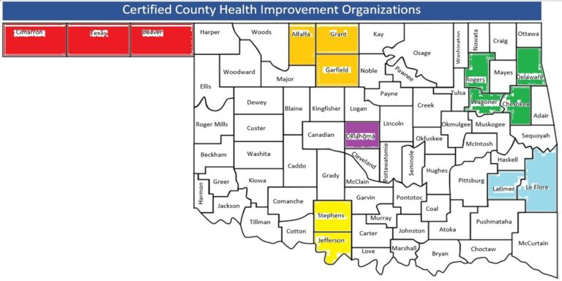
Expanding Infrastructure Support:
CHIOs + Community Coalition Coordinators + Community Partnership – Barrier Removal Funds
Planning Grant Aug. 1, 2022 – May 31, 2023 Funded by:
Notes:
Introductions

Slide 77
Individual & Family Adversities
Community & Structural Adversities
Family
Strengthening
Networks & Coalitions
Support
responsive
relationships & Strengthen core skills
Diversity e equity
belonging
& inclusion
Reduce
sources of
stress
(concrete needs)
Advance
leadership
skills &
co-design solutions
Handle With Care
& Multi-Tiered Systems of Support
Trauma- informed
policy & practices
Hope & Trauma
Interagency trainings
a
Social determinants
of health (SDOH) & Peer support groups
Parent/youth
advisory committees & family resource centers
Community
voice
Umbrella of Interagency Strategies: A Relational Framework for Strengthening Oklahoma Families & Communities Together
© Public Health Institute of Oklahoma, OK Parent Partnership Learning Community, OK Turning Point Council & OSDH
Notes:
Communities can utilize these relational strategies to complement efforts and build resilience.
Amber – to share local examples

Slide 78
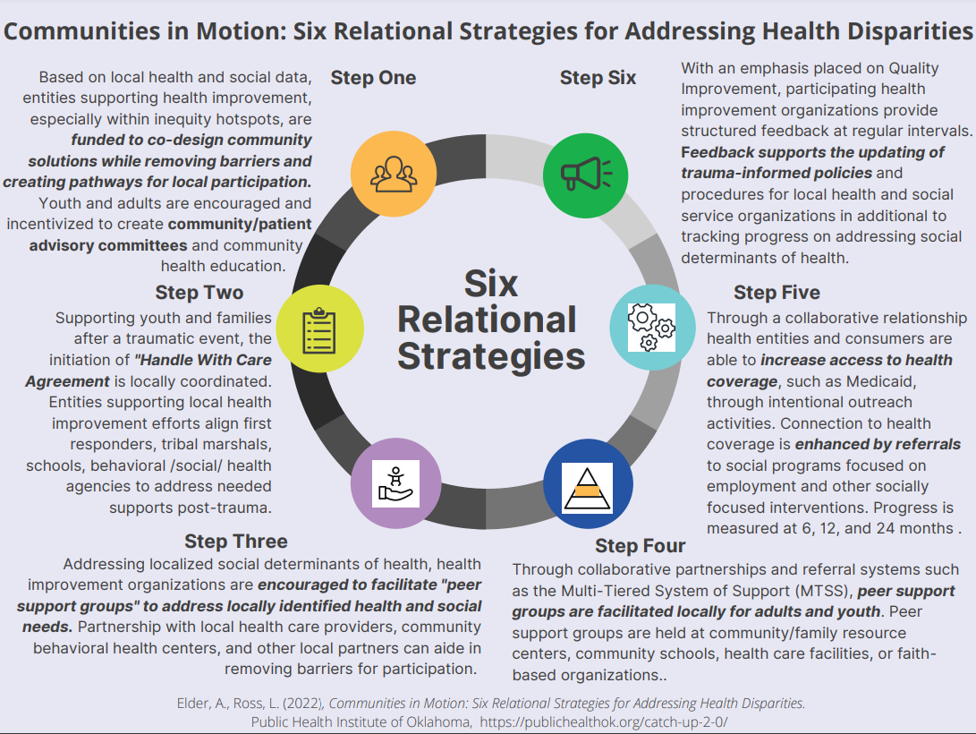
Examples of Community-Driven, Relational Health Improvement, & Interagency Efforts:
Notes:
Amber – to share local examples

Slide 79
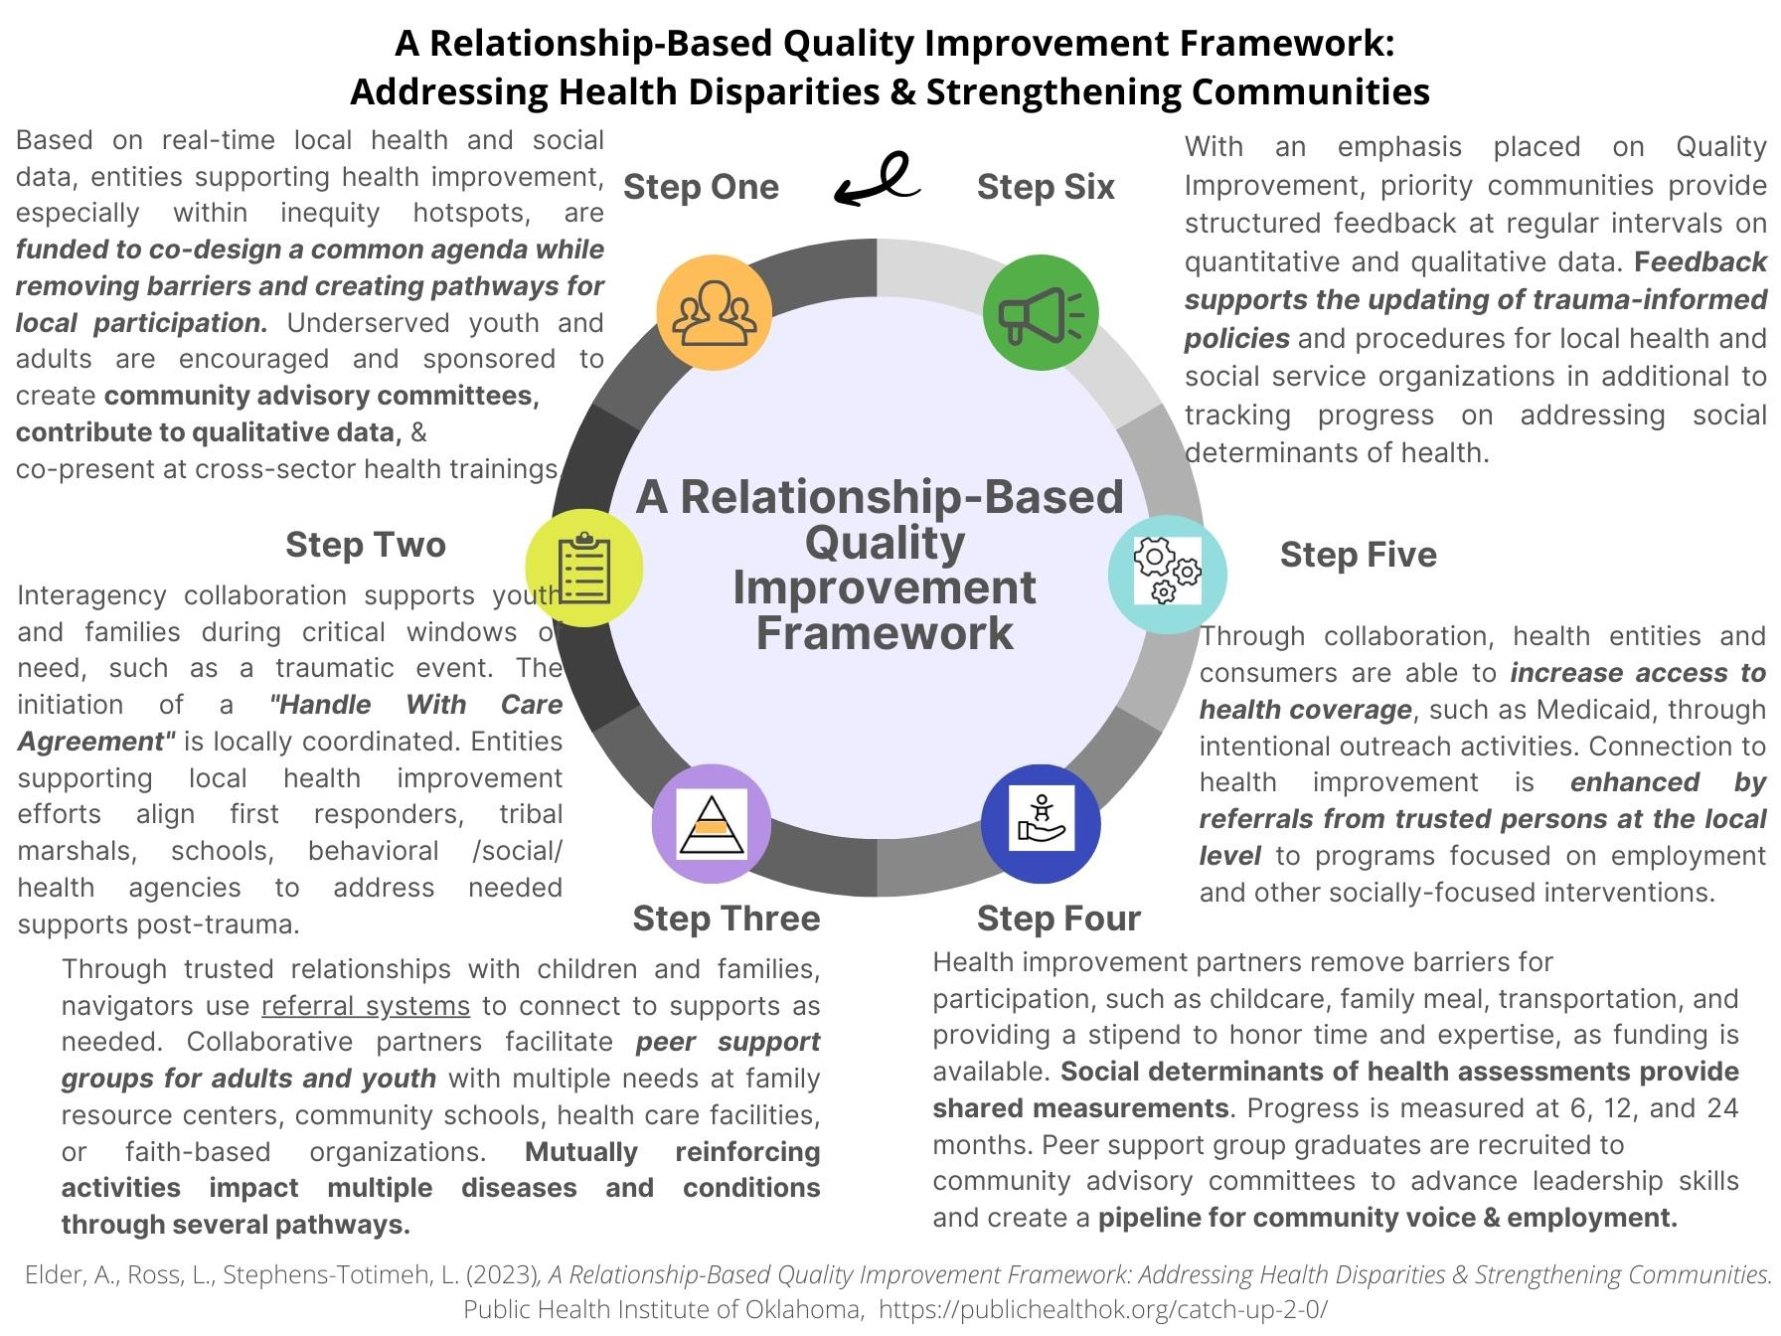
Notes:
Amber – to share local examples

Slide 80
Adrienne Ballew Elder holds a Master in Public Health and is the Director of Interagency
Contact info: info@handlewithcareok.org
Notes:
Introductions

